Slide 1
ENEE244-02xx Digital Logic Design
Lecture 10

Slide 2
Announcements
HW4 assigned, due 10/9

Slide 3
Agenda
Recap:
The simplification problem (4.1)
This time:
Prime Implicants (4.2)
Prime Implicates (4.3)
Karnaugh Maps (4.4)

Slide 4
The Simplification Problem
The determination of Boolean expressions that satisfy some criterion of minimality is the simplification or minimization problem.
We will assume cost is determined by number of gate inputs.

Slide 5
Prime Implicants
$f_{1}$implies $f_{2} (f_{1}→f_{2})$
There is no assignment of values to the n variables that makes $f_{1}$ equal to 1 and $f_{2}$ equal to 0.
Whenever $f_{1}$ equals 1, then $f_{2}$ must also equal 1.
Whenever $f_{2}$ equals 0, then $f_{1}$ must also equal 0.
Concept can be applied to terms and formulas.

Slide 6
Examples
Case of Disjunctive Normal Formula
Sum-of-products form
Each of the product terms implies the function being described by the formula
Whenever product term has value 1, function must also have value 1.
Case of Conjunctive Normal Formula
Product-of-sums form
Each sum term is implied by the function
Whenever the sum term has value 0, the function must also have value 0.

Slide 7
Subsumes
A term $t_{1}$is said to subsume a term $t_{2}$iff all the literals of the term $t_{2}$ are also literals of the term $t_{1}$.
Example: $x\overline{y} \overline{z}, x\overline{z}$
$x+\overline{y}+\overline{z}, x+\overline{z}$
If a product term $t_{1}$ subsumes a product term $t_{2}$, then $t_{1}$implies $t_{2}$.
Why?
If a sum term $t_{3}$ subsumes a sum term $t_{4}$, then $t_{4}$ implies $t_{3}$.
Why?

Slide 8
Subsumes
Theorem:
If one term subsumes another in an expression, then the subsuming term can always be deleted from the expression without changing the function being described.
CNF: $(x+y)(x + y + z)$
DNF: $xy+xyz$

Slide 9
Implicants and Prime Implicants
A product term is said to be an implicant of a complete function if the product term implies the function.
Each of the minterms in minterm canonical form is an implicant of the function.
An implicant of a function is a prime implicant if the implicant does not subsume any other implicant with fewer literals.

Slide 10
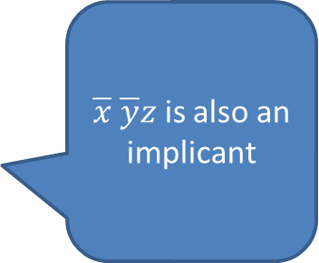
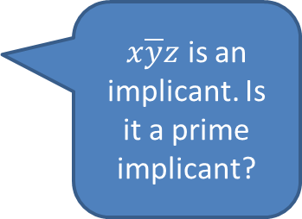
Example
$\overline{x} \overline{y}z$ is also an implicant
x | y | z | f
0 | 0 | 0 | 1
0 | 0 | 1 | 1
0 | 1 | 0 | 1
0 | 1 | 1 | 1
1 | 0 | 0 | 0
1 | 0 | 1 | 1
1 | 1 | 0 | 0
1 | 1 | 1 | 0
$x\overline{y}z$ is an implicant. Is it a prime implicant?
$\overline{y}z$ is an implicant.
Is it a prime implicant?
Yes. $\overline{y}, z$ are not implicants

Slide 11
Prime Implicants
Theorem:
When the cost for a minimal Boolean formula is such that decreasing the number of literals in the DNF formula decreases the cost of the formula, the minimal DNFs correspond to sums of prime implicants.
Proof:
Assume not. Then there is a DNF $D$ with minimal cost c that is not the sum of only prime implicants.
Let $t_{1}$ be one such term in $D$.
So $t_{1}$ implies the function and subsumes some $t_{2}$ which implies the function.
Add $t_{2}$to the formula.
Remove $t_{1}$ by the absorption law.
New expression with same number of terms but fewer literals.
This new expression has lower cost $c^{′}<c$ which contradicts minimality of $D.$

Slide 12
Irredundant Disjunctive Normal Formulas
Definition: An expression in sum-of-products form such that:
Every product term in the expression is a prime implicant
No product term may be eliminated from the expression without changing the function described by the expression.
Theorem:
When the cost of a formula decreases when a literal is removed, the minimal DNFs correspond to irredundant disjunctive normal formulas.

Slide 13
Prime Implicates and Irredundant Conjunctive Expressions
A sum term is said to be an implicate of a complete function if the function implies the sum term.
Each of the maxterms in maxterm canonical form is an implicate of the function.
An implicate of a function is a prime implicate if the implicate does not subsume any other implicate with fewer literals.

Slide 14
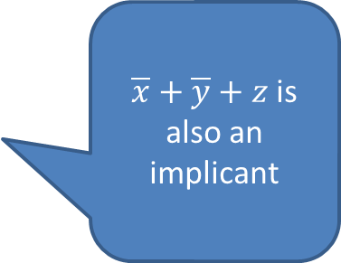
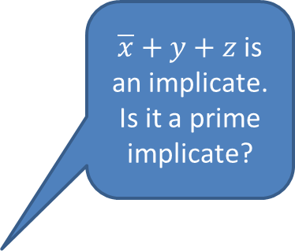
Example
x | y | z | f
0 | 0 | 0 | 1
0 | 0 | 1 | 1
0 | 1 | 0 | 1
0 | 1 | 1 | 1
1 | 0 | 0 | 0
1 | 0 | 1 | 1
1 | 1 | 0 | 0
1 | 1 | 1 | 0
$\overline{x}+y+z$is an implicate. Is it a prime implicate?
$\overline{x}+\overline{y}+z$ is also an implicant
$\overline{x}+z$ is an implicate.
Is it a prime implicate?
Yes. $\overline{x}, z$ are not implicates

Slide 15
Prime Implicates
Theorem:
When the cost for a minimal Boolean formula is such that decreasing the number of literals in the CNF formula decreases the cost of the formula, the minimal CNFs correspond to products of prime implicates.

Slide 16
Irredundant Conjunctive Normal Formulas
Definition: An expression in product-of-sums form such that:
Every sum term in the expression is a prime implicate
No sum term may be eliminated from the expression without changing the function described by the expression.
Theorem:
When the cost of a formula decreases when a literal is removed, the minimal CNFs correspond to irredundant conjunctive normal formulas.

Slide 17
Karnaugh Maps
Method for graphically determining implicants and implicates of a Boolean function.
Simplify Boolean functions and their logic gates implementation.
Geometrical configuration of $2^{n}$cells such that each of the $n$-tuples corresponding to the row of a truth table uniquely locates a cell on the map.
The functional values assigned to the n-tuples are placed as entries in the cells.
Structure of Karnaugh map:
Two cells are physically adjacent within the configuration iff their respective n-tuples differ in exactly one element.
E.g. (0,1,1), (0,1,0)
E.g. (1,0,1), (1,1,0)

Slide 18
Three-Variable Maps
Each cell is adjacent to 3 other cells.
Imagine the map lying on the surface of a cylinder.
$$yz$$
00
01
11
10
0
1 | 0 | 0 | 1
1 | 1 | 0 | 0
$$x$$
1

Slide 19
Four-Variable Maps
Each cell is adjacent to 4 other cells.
Imagine the map lying on the surface of a torus.
$$yz$$
00
01
11
10
00
1 | 1 | 0 | 1
1 | 1 | 0 | 0
0 | 0 | 0 | 0
1 | 0 | 0 | 1
01
$$wx$$
11
10

Slide 20
Karnaugh Maps and Canonical Formulas
Minterm Canonical Formula
$$yz$$
00
01
11
10
0
1 | 0 | 0 | 1
1 | 1 | 0 | 0
$$x$$
1
$$f\left(x\right)=\overline{x} \overline{y} \overline{z}+\overline{x}y\overline{z}+x\overline{y} \overline{z}+x\overline{y}z$$
$$=∑m(0,2,4,5)$$

Slide 21
Karnaugh Maps and Canonical Formulas
Maxterm Canonical Formula
$$yz$$
00
01
11
10
0
1 | 0 | 0 | 1
1 | 1 | 0 | 0
$$x$$
1
$$f\left(x\right)=(x+y+\overline{z})(x+\overline{y}+\overline{z})(\overline{x} \overline{y} \overline{z})(\overline{x} \overline{y}z)$$
$$=ΠM(1,3,6,7)$$

Slide 22
Karnaugh Maps and Canonical Formulas
Decimal Representation
$$yz$$
00
01
11
10
0
0 | 1 | 3 | 2
4 | 5 | 7 | 6
$$x$$
1

Slide 23
Karnaugh Maps and Canonical Formulas
Decimal Representation
$$yz$$
00
01
11
10
00
0 | 1 | 3 | 2
4 | 5 | 7 | 6
12 | 13 | 15 | 14
8 | 9 | 11 | 10
01
$$wx$$
11
10

Slide 24
Product Term Representations on Karnaugh Maps
Any set of 1-cells which form a $2^{a}×2^{b}$ rectangular grouping describes a product term with $n−a−b$ variables.
Rectangular groupings are referred to as subcubes.
The total number of cells in a subcube must be a power-of-two ($2^{a+b}$).
Two adjacent 1-cells: $\overline{w}x\overline{y}z+\overline{w}xyz$
$=\overline{w}xz\left(\overline{y}+y\right)=\overline{w}xz$

Slide 25
Examples of Subcubes

Slide 26
Subcubes for elimination of one variable
$$yz$$
00
01
11
10
00
 | 1 | 1
Variables in the product term are variables whose value is constant inside the subcube.
01
$$wx$$
11
10
Product term: $\overline{w}xz$

Slide 27
Subcubes for elimination of one variable
$$yz$$
00
01
11
10
00
1 |  |  | 1
01
$$wx$$
11
10
Product term: $wx\overline{z}$

Slide 28
Subcubes for elimination of one variable
$$yz$$
00
01
11
10
00
 |  | 1
 |  | 1
01
$$wx$$
11
10
Product term:$xyz$

Slide 29
Subcubes for elimination of one variable
$$yz$$
00
01
11
10
00
1
1
01
$$wx$$
11
10
Product term: $\overline{x} \overline{y} \overline{z}$

Slide 30
Subcubes for elimination of two variables
$$yz$$
00
01
11
10
00
1 | 1
1 | 1
01
$$wx$$
11
10
Product term: $x\overline{y}$

Slide 31
Subcubes for elimination of two variables
$$yz$$
00
01
11
10
00
 |  | 1
 |  | 1
 |  | 1
 |  | 1
01
$$wx$$
11
10
Product term: $yz$

Slide 32
Subcubes for elimination of two variables
$$yz$$
00
01
11
10
00
1 | 1 | 1 | 1
01
$$wx$$
11
10
Product term: $\overline{w} \overline{x}$

Slide 33
Subcubes for elimination of two variables
$$yz$$
00
01
11
10
00
1 |  |  | 1
1 |  |  | 1
01
$$wx$$
11
10
Product term: $w\overline{z}$

Slide 34
Subcubes for elimination of two variables
$$yz$$
00
01
11
10
00
1 |  |  | 1
1 |  |  | 1
01
$$wx$$
11
10
Product term: $\overline{x} \overline{z}$

Slide 35
Subcubes for elimination of three variables
$$yz$$
00
01
11
10
00
1 | 1 | 1 | 1
1 | 1 | 1 | 1
01
$$wx$$
11
10
Product term: $\overline{w}$

Slide 36
Subcubes for elimination of three variables
$$yz$$
00
01
11
10
00
 | 1 | 1
 | 1 | 1
 | 1 | 1
 | 1 | 1
01
$$wx$$
11
10
Product term: $\overline{w}$

Slide 37
Subcubes for elimination of three variables
$$yz$$
00
01
11
10
00
1 | 1 | 1 | 1
1 | 1 | 1 | 1
01
$$wx$$
11
10
Product term: $\overline{x}$

Slide 38
Subcubes for elimination of three variables
$$yz$$
00
01
11
10
00
1 |  |  | 1
1 |  |  | 1
1 |  |  | 1
1 |  |  | 1
01
$$wx$$
11
10
Product term: $\overline{z}$

Slide 39
Subcubes for sum terms
$$yz$$
00
01
11
10
00
0 | 0 | 0 | 0
0 | 0 | 0 | 0
 |  | 0 | 0
0 | 0 | 0 | 0
01
$$wx$$
11
10
Sum terms: $w+\overline{x}+y$
$$x+y$$
$$\overline{y}$$

Slide 40
Using K-Maps to Obtain Minimal Boolean Expressions

Slide 41
Example
$$yz$$
00
01
11
10
0
0 | 0 | 0 | 1
0 | 0 | 1 | 1
$$x$$
1
$$y\overline{z}$$
$$xy$$
Both are prime implicants
$$f=y\overline{z}+xy$$
How do we know this is minimal?

Slide 42
Finding the set of all prime implicants in an n-variable map:
If all $2^{n}$ entries are 1, then function is equal to 1.
For i = 1, 2. . . n
Search for all subcubes of dimensions $2^{a}×2^{b}=2^{n−i}$ that are not totally contained within a single previously obtained subcube.
Each of these subcubes represents an $i$ variable product term which implies the function.
Each product term is a prime implicant.

Slide 43
Essential Prime Implicants
Some 1-cells appear in only one prime implicant subcube, others appear in more than one.
A 1-cell that can be in only one prime implicant is called an essential prime implicant.
00
01
11
10
$$yz$$
0
1 | 1 | 0 | 0
0 | 1 | 1 | 0
$$x$$
1

Slide 44
Essential Prime Implicants
Every essential prime implicant must appear in all the irredundant disjunctive normal formulas of the function.
Hence must also appear in a minimal sum.
Why?

Slide 45
General Approach for Finding Minimal Sums

