Slide 1
Digital Logic Design
Lecture 14
based on video from: https://www.youtube.com/watch?v=pQ3MfzqGlrc

Slide 2
Announcements
HW5 due on 10/21
Quiz during recitation on Monday, 10/20.
Upcoming: Midterm on Tuesday, 10/28.

Slide 3
Agenda
Last time:
Minimal expressions for incomplete Boolean functions (4.6)
5 and 6 variable K-Maps (4.7)
Petrick’s method of determining irredundant expressions (4.9)
This time:
Quine-McCluskey method (4.8)
Prime Implicant Table Reductions (4.10)
The Multiple Output Simplification Problem (4.12)

Slide 4
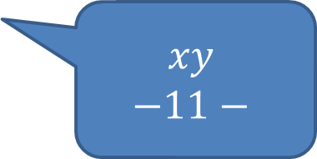
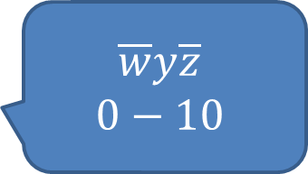
Tabular Representations
$$yz$$
00
01
11
10
$$\overline{w}y\overline{z}$$
$$0−10$$
$$\overline{w}x$$
$$01−−$$
0 | 0 | 0 | 1
1 | 1 | 1 | 1
0 | 1 | 1 | 1
0 | 1 | 0 | 0
00
01
$$wx$$
11
$$xy$$
$$−11−$$
$$w\overline{y}z$$
$$1−01$$
10
$$f\left(w,x,y,z\right)=xy+\overline{w}y\overline{z}+w\overline{y}z+\overline{w}x$$

Slide 5
Prime Implicants
$f\left(w,x,y,z\right)=xy+\overline{w}y\overline{z}+w\overline{y}z+\overline{w}x$
Each product term is an implicant.
Prime implicant: A product term that cannot have any of its literals removed and still imply the function.

Slide 6
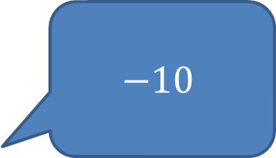
Prime Implicants
$$yz$$
$$−10$$
00
01
11
10
0
0 | 0 | 0 | 1
1 | 1 | 1 | 1
$$x$$
1
$$1−−$$

Slide 7
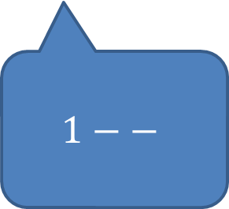
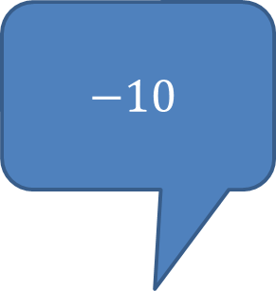
Prime Implicants
$$−10$$
$$yz$$
Minterm | X | Y | Z | F
0 | 0 | 0 | 0 | 0
1 | 0 | 0 | 1 | 0
2 | 0 | 1 | 0 | 1
3 | 0 | 1 | 1 | 0
4 | 1 | 0 | 0 | 1
5 | 1 | 0 | 1 | 1
6 | 1 | 1 | 0 | 1
7 | 1 | 1 | 1 | 1
00
01
11
10
0
0 | 0 | 0 | 1
1 | 1 | 1 | 1
$$x$$
1
$$1−−$$
$$f\left(x,y,z\right)=y\overline{z}+x$$

Slide 8
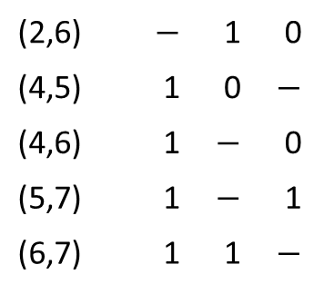
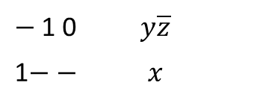
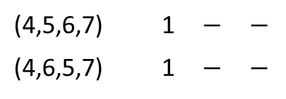
Finding Prime Implicants
Step 1
Step 2
Step 3
2 |  | 0 | 1 | 0
4 |  | 1 | 0 | 0
5 |  | 1 | 0 | 1
6 |  | 1 | 1 | 0
7 |  | 1 | 1 | 1
(2,6) |  | $$−$$ | 1 | 0
(4,5) |  | 1 | 0 | $$−$$
(4,6) |  | 1 | $$−$$ | 0
(5,7) |  | 1 | $$−$$ | 1
(6,7) |  | 1 | 1 | $$−$$
(4,5,6,7) |  | 1 | $$−$$ | $$−$$
(4,6,5,7) |  | 1 | $$−$$ | $$−$$
All unchecked entries are Prime Implicants
$−$1 0 |  | $$y\overline{z}$$
1$−$ $−$ |  | $$x$$

Slide 9
Prime Implicants
$$−10$$
$$yz$$
Minterm | X | Y | Z | F
0 | 0 | 0 | 0 | 0
1 | 0 | 0 | 1 | 0
2 | 0 | 1 | 0 | 1
3 | 0 | 1 | 1 | 0
4 | 1 | 0 | 0 | 1
5 | 1 | 0 | 1 | 1
6 | 1 | 1 | 0 | 1
7 | 1 | 1 | 1 | 1
00
01
11
10
0
0 | 0 | 0 | 1
1 | 1 | 1 | 1
$$x$$
1
$$1−−$$
$$f\left(x,y,z\right)=y\overline{z}+x$$

Slide 10
Essential Prime Implicants
$$yz$$
00
01
11
10
Find the Essential Prime Implicants using Quine-McClusky
00
1 | 1 | 1 | 1
0 | 1 | 1 | 0
0 | 0 | 1 | 1
1 | 0 | 0 | 1
01
$$wx$$
11
10

Slide 11
Essential Prime Implicants
$$yz$$
minterms
00
01
11
10
1 | 1 | 1 | 1
0 | 1 | 1 | 0
0 | 0 | 1 | 1
1 | 0 | 0 | 1
0 |  | 0 | 0 | 0 | 0
1 |  | 0 | 0 | 0 | 1
2 |  | 0 | 0 | 1 | 0
8 |  | 1 | 0 | 0 | 0
3 |  | 0 | 0 | 1 | 1
5 |  | 0 | 1 | 0 | 1
10 |  | 1 | 0 | 1 | 0
7 |  | 0 | 1 | 1 | 1
14 |  | 1 | 1 | 1 | 0
15 |  | 1 | 1 | 1 | 1
00
01
$$wx$$
11
10

Slide 12
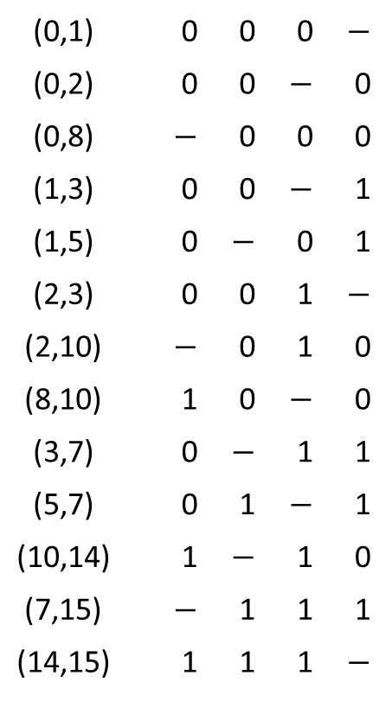
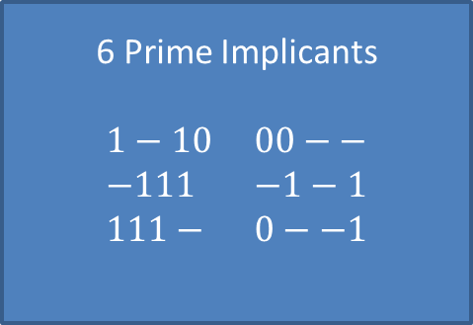
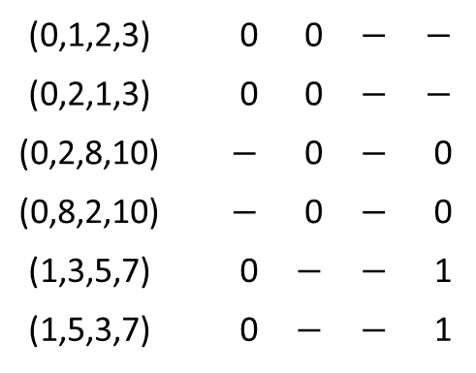
Finding Prime Implicants
0 |  | 0 | 0 | 0 | 0
1 |  | 0 | 0 | 0 | 1
2 |  | 0 | 0 | 1 | 0
8 |  | 1 | 0 | 0 | 0
3 |  | 0 | 0 | 1 | 1
5 |  | 0 | 1 | 0 | 1
10 |  | 1 | 0 | 1 | 0
7 |  | 0 | 1 | 1 | 1
14 |  | 1 | 1 | 1 | 0
15 |  | 1 | 1 | 1 | 1
(0,1) |  | 0 | 0 | 0 | $$−$$
(0,2) |  | 0 | 0 | $$−$$ | 0
(0,8) |  | $$−$$ | 0 | 0 | 0
(1,3) |  | 0 | 0 | $$−$$ | 1
(1,5) |  | 0 | $$−$$ | 0 | 1
(2,3) |  | 0 | 0 | 1 | $$−$$
(2,10) |  | $$−$$ | 0 | 1 | 0
(8,10) |  | 1 | 0 | $$−$$ | 0
(3,7) |  | 0 | $$−$$ | 1 | 1
(5,7) |  | 0 | 1 | $$−$$ | 1
(10,14) |  | 1 | $$−$$ | 1 | 0
(7,15) |  | $$−$$ | 1 | 1 | 1
(14,15) |  | 1 | 1 | 1 | $$−$$
(0,1,2,3) |  | 0 | 0 | $$−$$ | $$−$$
(0,2,1,3) |  | 0 | 0 | $$−$$ | $$−$$
(0,2,8,10) |  | $$−$$ | 0 | $$−$$ | 0
(0,8,2,10) |  | $$−$$ | 0 | $$−$$ | 0
(1,3,5,7) |  | 0 | $$−$$ | $$−$$ | 1
(1,5,3,7) |  | 0 | $$−$$ | $$−$$ | 1
6 Prime Implicants
$1−10$ $00−−$
$−111$ $−1−1$
$111−$ $0−−1$

Slide 13
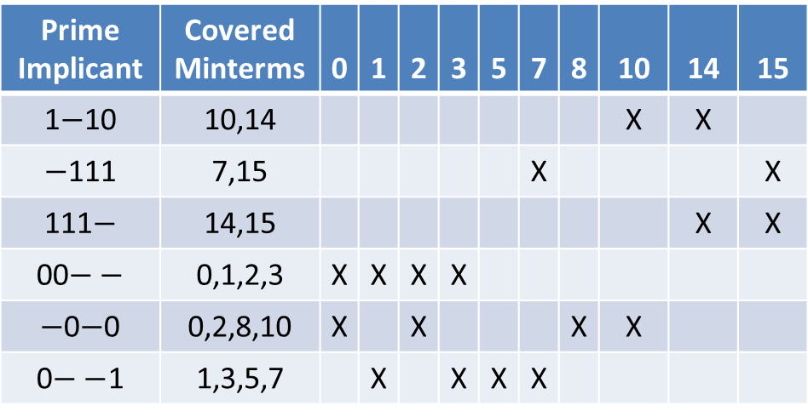
Find Essential Prime Implicants
Prime Implicant | Covered Minterms | 0 | 1 | 2 | 3 | 5 | 7 | 8 | 10 | 14 | 15
1$−$10 | 10,14 |  |  |  |  |  |  |  | X | X
$−$111 | 7,15 |  |  |  |  |  | X |  |  |  | X
111$−$ | 14,15 |  |  |  |  |  |  |  |  | X | X
00$−−$ | 0,1,2,3 | X | X | X | X
$−$0$−$0 | 0,2,8,10 | X |  | X |  |  |  | X | X
0$−−$1 | 1,3,5,7 |  | X |  | X | X | X
Minterms

Slide 14
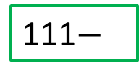
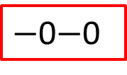
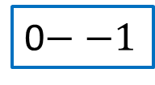
3 Prime Implicants
$$yz$$
0$−−1$
00
01
11
10
00
1 | 1 | 1 | 1
0 | 1 | 1 | 0
0 | 0 | 1 | 1
1 | 0 | 0 | 1
01
$$wx$$
11
111$−$
10
$−$0$−$0

Slide 15
3 Prime Implicants
$$yz$$
0$−−1$
00
01
11
10
00
1 | 1 | 1 | 1
0 | 1 | 1 | 0
0 | 0 | 1 | 1
1 | 0 | 0 | 1
01
$$wx$$
11
111$−$
10
$−$0$−$0
$$f\left(w,x,y,z\right)=\overline{w}z+\overline{x} \overline{z}+wxy$$

Slide 16
Column and Row Reductions

Slide 17
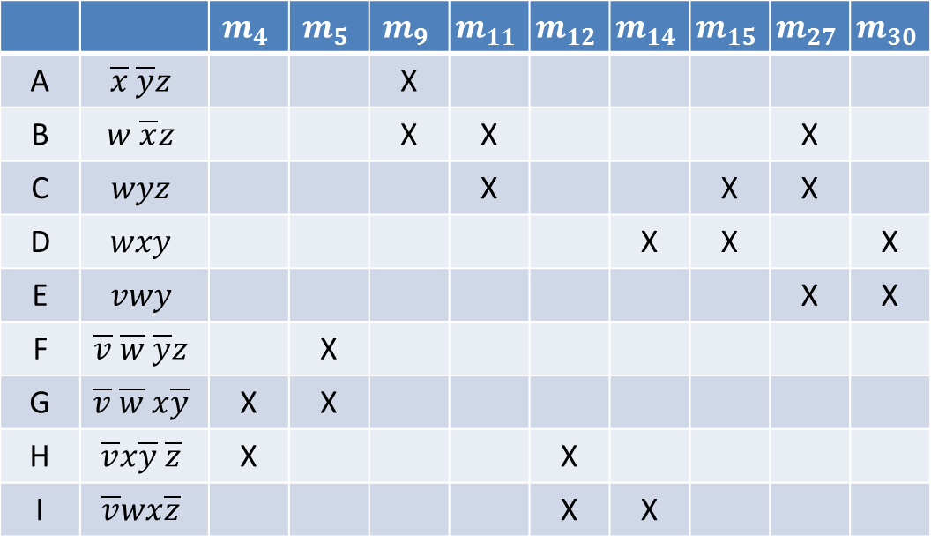
Example
 |  | $$m_{4}$$ | $$m_{5}$$ | $$m_{9}$$ | $$m_{11}$$ | $$m_{12}$$ | $$m_{14}$$ | $$m_{15}$$ | $$m_{27}$$ | $$m_{30}$$
A | $$\overline{x} \overline{y}z$$ |  |  | X
B | $$w \overline{x}z$$ |  |  | X | X |  |  |  | X
C | $$wyz$$ |  |  |  | X |  |  | X | X
D | $$wxy$$ |  |  |  |  |  | X | X |  | X
E | $$vwy$$ |  |  |  |  |  |  |  | X | X
F | $$\overline{v} \overline{w} \overline{y}z$$ |  | X
G | $$\overline{v} \overline{w} x\overline{y}$$ | X | X
H | $$\overline{v}x\overline{y} \overline{z}$$ | X |  |  |  | X
I | $$\overline{v}wx\overline{z}$$ |  |  |  |  | X | X

Slide 18
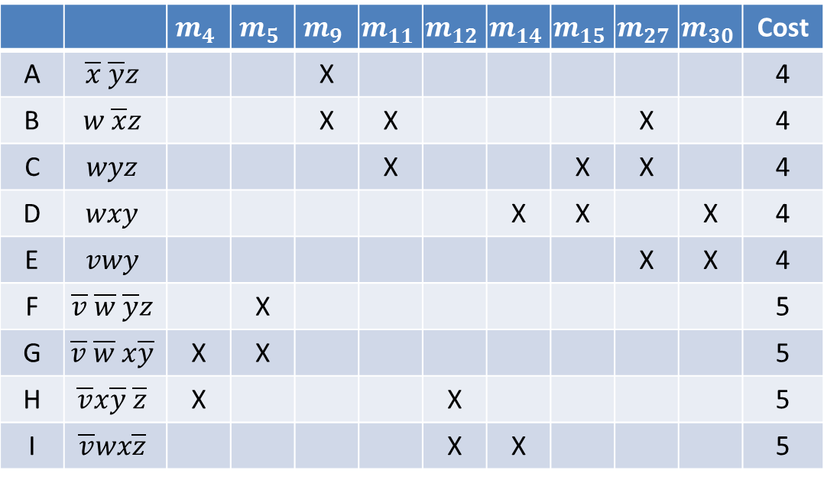
Example
Cost is 1 plus number of literals in the term
 |  | $$m_{4}$$ | $$m_{5}$$ | $$m_{9}$$ | $$m_{11}$$ | $$m_{12}$$ | $$m_{14}$$ | $$m_{15}$$ | $$m_{27}$$ | $$m_{30}$$ | Cost
A | $$\overline{x} \overline{y}z$$ |  |  | X |  |  |  |  |  |  | 4
B | $$w \overline{x}z$$ |  |  | X | X |  |  |  | X |  | 4
C | $$wyz$$ |  |  |  | X |  |  | X | X |  | 4
D | $$wxy$$ |  |  |  |  |  | X | X |  | X | 4
E | $$vwy$$ |  |  |  |  |  |  |  | X | X | 4
F | $$\overline{v} \overline{w} \overline{y}z$$ |  | X |  |  |  |  |  |  |  | 5
G | $$\overline{v} \overline{w} x\overline{y}$$ | X | X |  |  |  |  |  |  |  | 5
H | $$\overline{v}x\overline{y} \overline{z}$$ | X |  |  |  | X |  |  |  |  | 5
I | $$\overline{v}wx\overline{z}$$ |  |  |  |  | X | X |  |  |  | 5

Slide 19
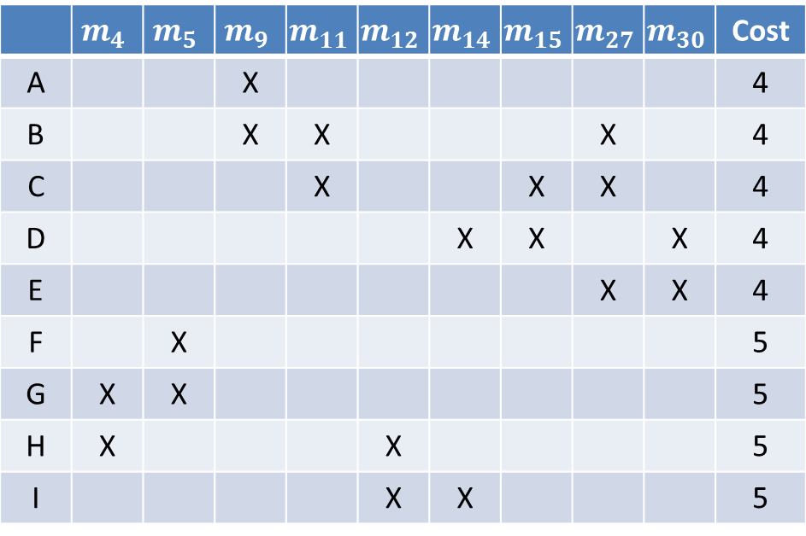
Example
 | $$m_{4}$$ | $$m_{5}$$ | $$m_{9}$$ | $$m_{11}$$ | $$m_{12}$$ | $$m_{14}$$ | $$m_{15}$$ | $$m_{27}$$ | $$m_{30}$$ | Cost
A |  |  | X |  |  |  |  |  |  | 4
B |  |  | X | X |  |  |  | X |  | 4
C |  |  |  | X |  |  | X | X |  | 4
D |  |  |  |  |  | X | X |  | X | 4
E |  |  |  |  |  |  |  | X | X | 4
F |  | X |  |  |  |  |  |  |  | 5
G | X | X |  |  |  |  |  |  |  | 5
H | X |  |  |  | X |  |  |  |  | 5
I |  |  |  |  | X | X |  |  |  | 5

Slide 20
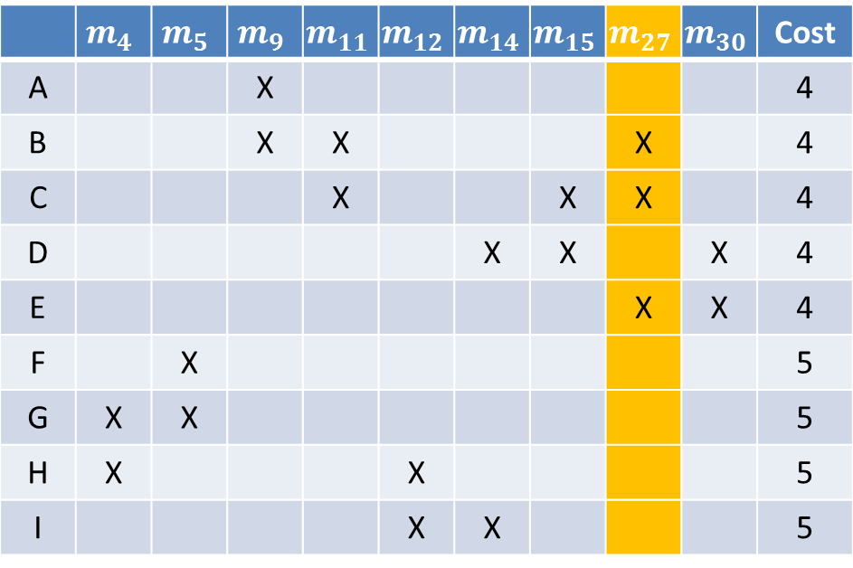
Example
Dominating Column: Column $m_{27}$ has X’s in all the rows in which column $m_{11}$ has X’s and column $m_{27}$ has at least one more X.
 | $$m_{4}$$ | $$m_{5}$$ | $$m_{9}$$ | $$m_{11}$$ | $$m_{12}$$ | $$m_{14}$$ | $$m_{15}$$ | $$m_{27}$$ | $$m_{30}$$ | Cost
A |  |  | X |  |  |  |  |  |  | 4
B |  |  | X | X |  |  |  | X |  | 4
C |  |  |  | X |  |  | X | X |  | 4
D |  |  |  |  |  | X | X |  | X | 4
E |  |  |  |  |  |  |  | X | X | 4
F |  | X |  |  |  |  |  |  |  | 5
G | X | X |  |  |  |  |  |  |  | 5
H | X |  |  |  | X |  |  |  |  | 5
I |  |  |  |  | X | X |  |  |  | 5

Slide 21
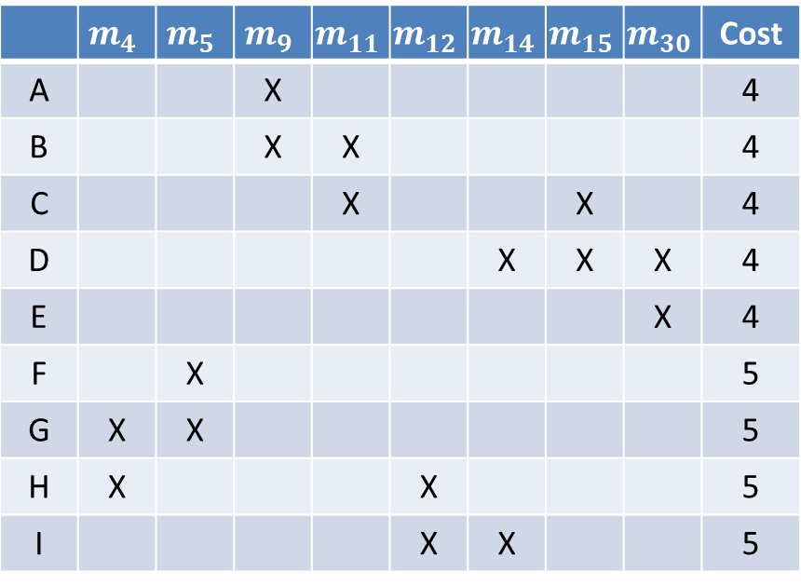
Example
Delete column $m_{27}$. Why is this ok?
 | $$m_{4}$$ | $$m_{5}$$ | $$m_{9}$$ | $$m_{11}$$ | $$m_{12}$$ | $$m_{14}$$ | $$m_{15}$$ | $$m_{30}$$ | Cost
A |  |  | X |  |  |  |  |  | 4
B |  |  | X | X |  |  |  |  | 4
C |  |  |  | X |  |  | X |  | 4
D |  |  |  |  |  | X | X | X | 4
E |  |  |  |  |  |  |  | X | 4
F |  | X |  |  |  |  |  |  | 5
G | X | X |  |  |  |  |  |  | 5
H | X |  |  |  | X |  |  |  | 5
I |  |  |  |  | X | X |  |  | 5

Slide 22
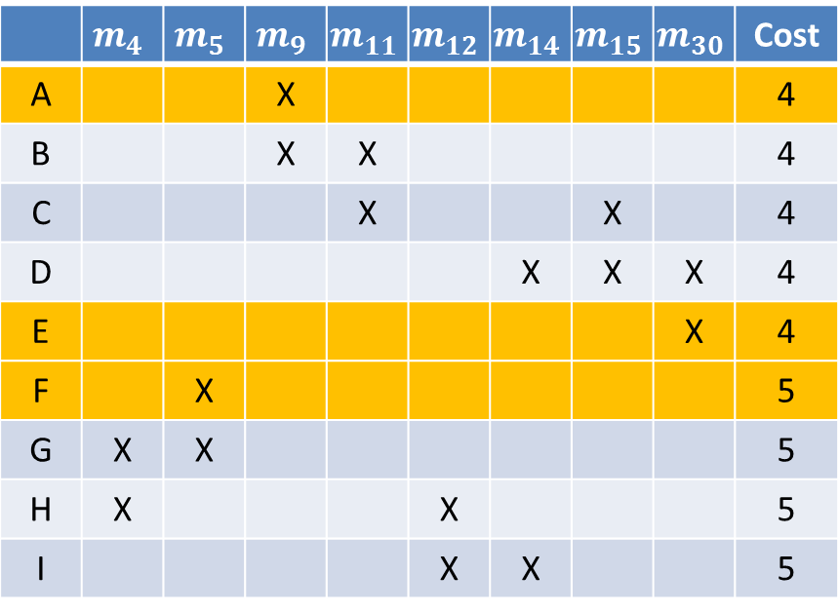
Example
Dominated rows: A is dominated by B since B has X’s in all columns in which A has X’s and B has at least one more X.
 | $$m_{4}$$ | $$m_{5}$$ | $$m_{9}$$ | $$m_{11}$$ | $$m_{12}$$ | $$m_{14}$$ | $$m_{15}$$ | $$m_{30}$$ | Cost
A |  |  | X |  |  |  |  |  | 4
B |  |  | X | X |  |  |  |  | 4
C |  |  |  | X |  |  | X |  | 4
D |  |  |  |  |  | X | X | X | 4
E |  |  |  |  |  |  |  | X | 4
F |  | X |  |  |  |  |  |  | 5
G | X | X |  |  |  |  |  |  | 5
H | X |  |  |  | X |  |  |  | 5
I |  |  |  |  | X | X |  |  | 5
Which rows dominate E and F?

Slide 23
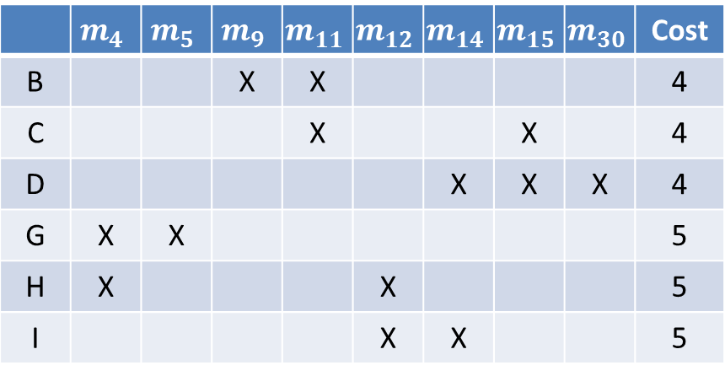
Example
Delete rows A, E, F since dominated row has cost equal to its dominating row. Why is this ok?
 | $$m_{4}$$ | $$m_{5}$$ | $$m_{9}$$ | $$m_{11}$$ | $$m_{12}$$ | $$m_{14}$$ | $$m_{15}$$ | $$m_{30}$$ | Cost
B |  |  | X | X |  |  |  |  | 4
C |  |  |  | X |  |  | X |  | 4
D |  |  |  |  |  | X | X | X | 4
G | X | X |  |  |  |  |  |  | 5
H | X |  |  |  | X |  |  |  | 5
I |  |  |  |  | X | X |  |  | 5

Slide 24

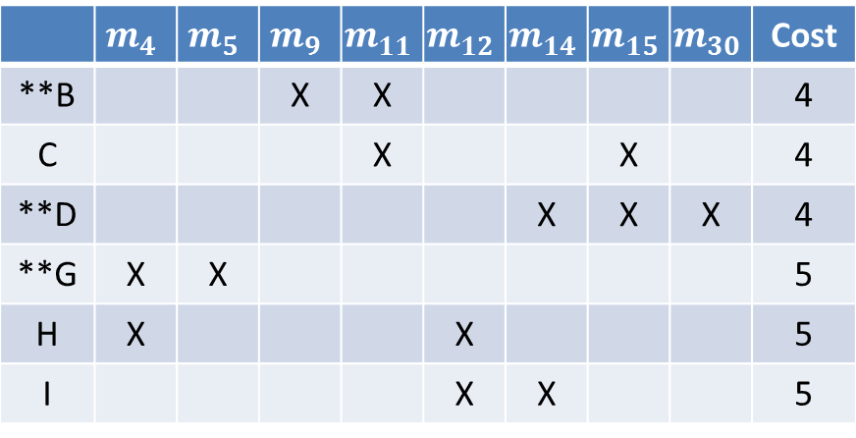
Example
B is the only row that covers $m_{9}$, D is the only row that covers $m_{30}$, G is the only row that covers $m_{5}.$
 | $$m_{4}$$ | $$m_{5}$$ | $$m_{9}$$ | $$m_{11}$$ | $$m_{12}$$ | $$m_{14}$$ | $$m_{15}$$ | $$m_{30}$$ | Cost
**B |  |  | X | X |  |  |  |  | 4
C |  |  |  | X |  |  | X |  | 4
**D |  |  |  |  |  | X | X | X | 4
**G | X | X |  |  |  |  |  |  | 5
H | X |  |  |  | X |  |  |  | 5
I |  |  |  |  | X | X |  |  | 5

Slide 25
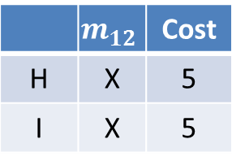
Example
Can select either H or I since they both have the same cost.
 | $$m_{12}$$ | Cost
H | X | 5
I | X | 5
Final minimal cover is either:
B,D,G,H
B,D,G,I
Note: Unlike Petrick’s method, not all minimal covers are necessarily obtained.

Slide 26
Summary: Prime Implicant Selection Procedure
Find all essential prime implicants. Rule a line through the essential rows and all columns which have an X in an essential row.
Rule a line through all dominating columns and dominated rows, keeping in mind the cost restriction for deleting rows.
Check to see if any unruled column has a single X. If there are no such columns, then the table is cyclic. If there are some columns with a single X, place a double asterisk next to the rows in which these X’s appear. These are called secondary essential rows. Rule a line through each secondary essential row and each column in which an X appears in a secondary essential row.
If all columns are ruled out, then the minimal sum is given by the sum of all the prime implicants which are associated with rows that have asterisks next to them. If all columns are not ruled out, then repeat Steps 2 and 3 until either there are no columns to be ruled or a cyclic table results.
If a cyclic table results, then Petrick’s method is applied to the cyclic table and a minimal cover is obtained for it. The sum of all prime implicants that are marked with asterisks plus the prime implicants for the minimal cover of the cyclic table as determined by Petrick’s method is a minimal sum.

Slide 27
Multiple Output Minimal Sums and Products

Slide 28
The Multiple-Output Simplification Problem
General combinational networks can have several output terminals.
The output behavior of the network is described by a set of functions $f_{1},f_{2}, …, f_{m}$, one for each output terminal, each involving the same input variables, $x_{1}, x_{2},…, x_{n}$.
The set of functions is represented by a truth table with $m+n$ columns.
Objective is to design a multiple-output network of minimal cost.
Formally: A set of normal expressions that has associated with it a minimal cost as given by some cost criteria.
Cost criteria: number of gates or number of gate inputs in the realization.

Slide 29
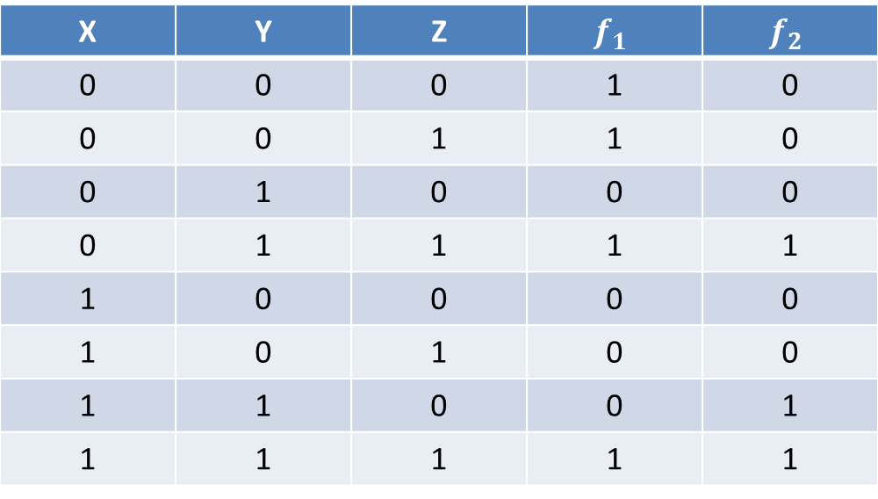
Naïve Approach
Construct a minimal expression for each output function independently of the others.
Example:
X | Y | Z | $$f_{1}$$ | $$f_{2}$$
0 | 0 | 0 | 1 | 0
0 | 0 | 1 | 1 | 0
0 | 1 | 0 | 0 | 0
0 | 1 | 1 | 1 | 1
1 | 0 | 0 | 0 | 0
1 | 0 | 1 | 0 | 0
1 | 1 | 0 | 0 | 1
1 | 1 | 1 | 1 | 1

Slide 30
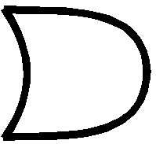
Naïve Approach
Using K-Maps, the minimal sum for each function is:
$f_{1}\left(x,y,z\right)=\overline{x} \overline{y}+yz$
$f_{2}\left(x,y,z\right)=yz+xy$
$$\overline{x}$$
$$y$$
$$\overline{y}$$
$$z$$
$$f_{1}$$
$$f_{2}$$
$$y$$
$$x$$
$$z$$
$$y$$

Slide 31
A More Economical Realization
Shared term $yz$
$$\overline{x}$$
$$\overline{y}$$
$$f_{1}$$
$$y$$
$$z$$
$$f_{2}$$
$$x$$
$$y$$

Slide 32
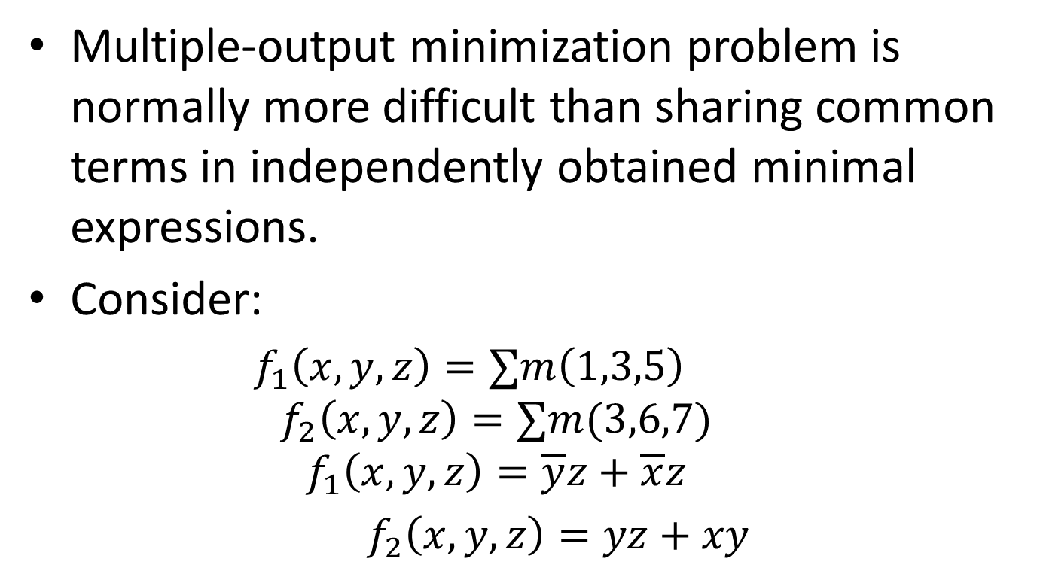
Pitfalls of Naïve Approach
Multiple-output minimization problem is normally more difficult than sharing common terms in independently obtained minimal expressions.
Consider:
$f_{1}\left(x,y,z\right)=∑m\left(1,3,5\right)$
$$f_{2}\left(x,y,z\right)=∑m(3,6,7)$$
$$f_{1}\left(x,y,z\right)=\overline{y}z+\overline{x}z$$
$f_{2}\left(x,y,z\right)=yz+xy$

Slide 33
Pitfalls of Naïve Approach
Naïve Approach:
$$\overline{y}$$
$$y$$
$$z$$
$$z$$
$$f_{1}$$
$$f_{2}$$
$$\overline{x}$$
$$x$$
$$z$$
$$y$$
Better Approach:
$$\overline{y}$$
$$z$$
$$f_{1}$$
$$\overline{x}$$
$$y$$
$$z$$
$$f_{2}$$
$$x$$
$$y$$

