Slide 1
ENEE244-020x Digital Logic Design
Lecture 20

Slide 2
Announcements
Homework 6 due today.
Homework 7 up on course webpage, due on 11/13.
Recitation quiz on Monday, 11/10
Will cover material from lectures 18,19,20
Exams to be returned at end of lecture.

Slide 3
Agenda
Last time:
Decimal Adders (5.2)
Comparators (5.3)
Decoders (5.4)
Encoders (5.5)
This time:
Multiplexers (5.6)
Programmable Logic Devices (5.7)
Programmable Read-Only Memories (PROM) (5.8)

Slide 4
Multiplexer
Also called data selectors.
Basic function: select one of its $2^{n}$ data input lines and place the corresponding information onto a single output line.
$n$ input bits needed to specify which input line is to be selected.
Place binary code for a desired data input line onto its $n$ select input lines.

Slide 5
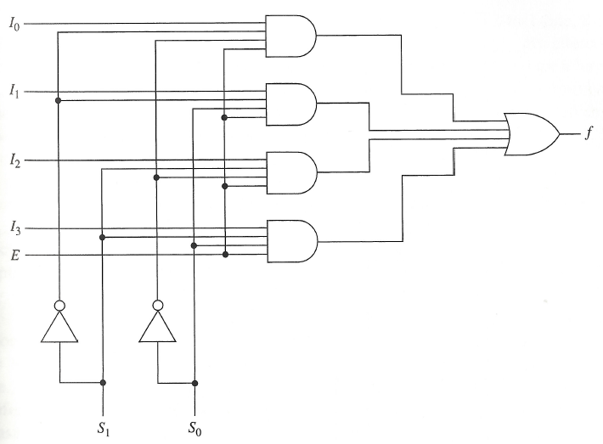
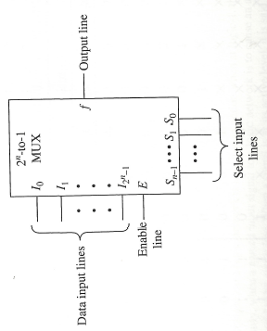
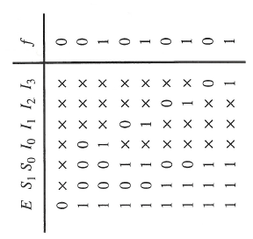
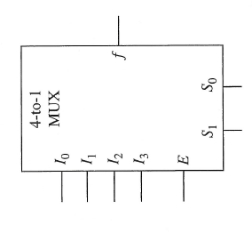
Realization of 4-to-1 line multiplexer
Symbol
Logic Diagram
Truth Table

Slide 6
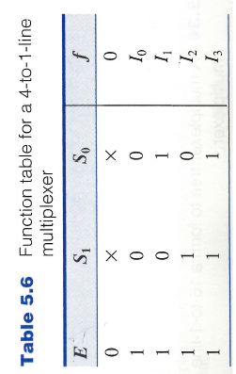
Realization of 4-to-1 line multiplexer
Alternate description:
Algebraic description of multiplexer:
$$f= \left(I_{0}{\overline{S}}_{1}{\overline{S}}_{0}+I_{1}{\overline{S}}_{1}S_{0}+I_{2}S_{1}{\overline{S}}_{0}+I_{3}S_{1}S_{2}\right)E$$

Slide 7
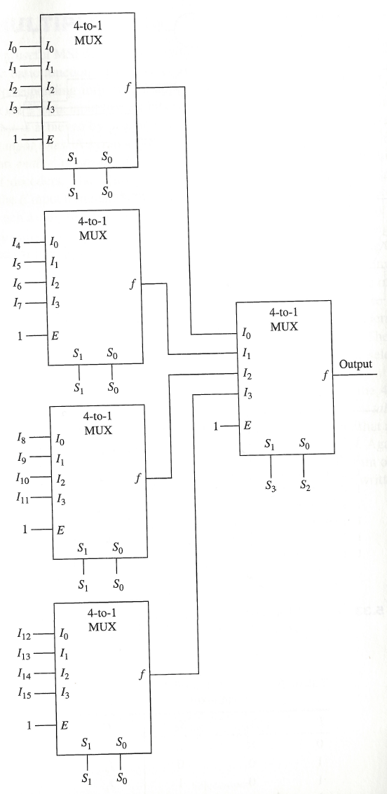
Building a Large Multiplexer

Slide 8
Multiplexers
One of the primary applications of multiplexers is to provide for the transmission of information from several sources over a single path.
This process is known as multiplexing.
Demultiplexer = decoder with an enable input.

Slide 9
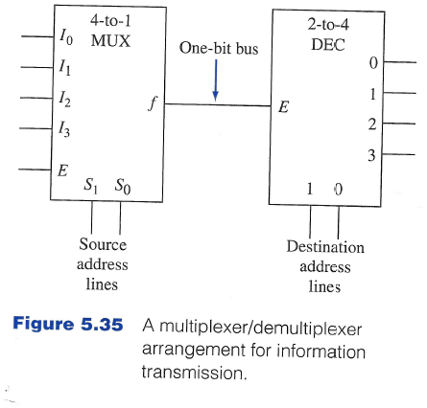
Multiplexer/Demultiplexer for information transmission

Slide 10
Logic Design with Multiplexers
$$x$$ | $$y$$ | $$z$$ | $$f$$
0 | 0 | 0 | $$f_{0}$$
0 | 0 | 1 | $$f_{1}$$
0 | 1 | 0 | $$f_{2}$$
0 | 1 | 1 | $$f_{3}$$
1 | 0 | 0 | $$f_{4}$$
1 | 0 | 1 | $$f_{5}$$
1 | 1 | 0 | $$f_{6}$$
1 | 1 | 1 | $$f_{7}$$
The Boolean expression corresponding to this truth table can be written as:
$$f\left(x,y,z\right)=f_{0}⋅\overline{x} \overline{y} \overline{z}+f_{1}⋅\overline{x} \overline{y} z+f_{2}⋅\overline{x}y\overline{z}+f_{3}⋅\overline{x}yz+f_{4}⋅x\overline{y} \overline{z}+f_{5}⋅x\overline{y}z+f_{6}xy\overline{z}+f_{7}⋅xyz.$$

Slide 11
Logic Design with Multiplexers
The Boolean expression corresponding to this truth table can be written as:
$f\left(x,y,z\right)=f_{0}⋅\overline{x} \overline{y} \overline{z}+f_{1}⋅\overline{x} \overline{y} z+f_{2}⋅\overline{x}y\overline{z}+f_{3}⋅\overline{x}yz+f_{4}⋅x\overline{y} \overline{z}+f_{5}⋅x\overline{y}z+f_{6}xy\overline{z}+f_{7}⋅xyz.$
The Boolean expression for an 8-to-1-line multiplexer is:
$$f=\left(I_{0}{\overline{S}}_{2}{\overline{S}}_{1}{\overline{S}}_{0}+I_{1}{\overline{S}}_{2}{\overline{S}}_{1}S_{0}+I_{2}{\overline{S}}_{2}S_{1}{\overline{S}}_{0}+I_{3}{\overline{S}}_{2}S_{1}S_{0}+I_{4}S_{2}{\overline{S}}_{1}{\overline{S}}_{0}+I_{5}S_{2}{\overline{S}}_{1}S_{0}+I_{6}S_{2}S_{1}{\overline{S}}_{0}+I_{7}S_{2}S_{1}S_{0}\right).$$

Slide 12
Logic Design with Multiplexers
If E is logic-1 then the latter is transformed into the former by replacing $I_{i}$ with $f_{i}$, $S_{2}$ with $x$, $S_{1}$ with $y$, and $S_{0}$ with z.
Placing $x,y,z$ on the select lines $S_{2},S_{1},S_{0}$, respectively and placing the functional values $f_{i}$ on data input lines $I_{i}$.
$$f_{0}$$
8-to-1
MUX
$$I_{0}$$
$$f_{1}$$
$$I_{1}$$
$$f_{2}$$
$$I_{2}$$
$$f_{3}$$
$$I_{3}$$
$$f$$
$$f_{4}$$
$$I_{4}$$
$$f_{5}$$
$$I_{5}$$
$$f_{6}$$
$$I_{6}$$
$$f_{7}$$
$$I_{7}$$
$$1$$
$$E$$
$$S_{2}$$
$$S_{1}$$
$$S_{0}$$
$$x$$
$$y$$
$$z$$

Slide 13
Example:
$$x$$ | $$y$$ | $$z$$ | $$f$$
0 | 0 | 0 | $$1$$
0 | 0 | 1 | $$0$$
0 | 1 | 0 | $$1$$
0 | 1 | 1 | $$1$$
1 | 0 | 0 | $$0$$
1 | 0 | 1 | $$1$$
1 | 1 | 0 | $$0$$
1 | 1 | 1 | $$0$$
8-to-1
MUX
$$1$$
$$I_{0}$$
$$0$$
$$I_{1}$$
$$1$$
$$I_{2}$$
$$1$$
$$I_{3}$$
$$0$$
$$f$$
$$I_{4}$$
$$1$$
$$I_{5}$$
$$0$$
$$I_{6}$$
$$0$$
$$I_{7}$$
$$1$$
$$E$$
$$S_{2}$$
$$S_{1}$$
$$S_{0}$$
$$x$$
$$y$$
$$z$$

Slide 14
Logic Design with Multiplexers
If at least one input variable of a Boolean function is available in both its complemented and uncomplemented form, any $n$-variable function is realizable with a $2^{n−1}$-to-1-line multiplexer.
For the case of a 3-variable function, only a 4-to-1 multiplexer is needed.
$f\left(x,y,z\right)=f_{0}⋅\overline{x} \overline{y} \overline{z}+f_{1}⋅\overline{x} \overline{y} z+f_{2}⋅\overline{x}y\overline{z}+f_{3}⋅\overline{x}yz+f_{4}⋅x\overline{y} \overline{z}+f_{5}⋅x\overline{y}z+f_{6}xy\overline{z}+f_{7}⋅xyz$
$$=\left(f_{0}⋅\overline{z}+f_{1}⋅z\right)\overline{x} \overline{y}+\left(f_{2}⋅\overline{z}+f_{3}⋅z\right)\overline{x}y+\left(f_{4}⋅\overline{z}+f_{5}⋅z\right)x\overline{y}+\left(f_{6}⋅\overline{z}+f_{7}⋅z\right)xy$$
When E = 1, 4-to-1 Multiplexer has the form
$$I_{0}{\overline{S}}_{1}{\overline{S}}_{0}+I_{1}{\overline{S}}_{1}S_{0}+I_{2}S_{1}{\overline{S}}_{0}+I_{3}S_{1}S_{2}$$

Slide 15
Logic Design with Multiplexers
$$f(x,y,z)=\left(f_{0}⋅\overline{z}+f_{1}⋅z\right)\overline{x} \overline{y}+\left(f_{2}⋅\overline{z}+f_{3}⋅z\right)\overline{x}y+\left(f_{4}⋅\overline{z}+f_{5}⋅z\right)x\overline{y}+\left(f_{6}⋅\overline{z}+f_{7}⋅z\right)xy$$
4-to-1 Multiplexer has the form
$$f= I_{0}{\overline{S}}_{1}{\overline{S}}_{0}+I_{1}{\overline{S}}_{1}S_{0}+I_{2}S_{1}{\overline{S}}_{0}+I_{3}S_{1}S_{2}$$
Realization of $f(x,y,z)$ is obtained by placing the $x$ and $y$ variables on the $S_{1}, S_{0}$select lines, the single variable functions $f_{i}⋅\overline{z}+f_{j}⋅z$ on the data input lines and let E = 1.
Note: $f_{i}⋅\overline{z}+f_{j}⋅z$ reduce to 0,1,$z$ or $\overline{z}$.

Slide 16
Example
$$x$$ | $$y$$ | $$z$$ | $$f$$
0 | 0 | 0 | $$1$$
0 | 0 | 1 | $$0$$
0 | 1 | 0 | $$1$$
0 | 1 | 1 | $$1$$
1 | 0 | 0 | $$0$$
1 | 0 | 1 | $$1$$
1 | 1 | 0 | $$0$$
1 | 1 | 1 | $$0$$
$$f_{0}⋅\overline{z}+f_{1}⋅z$$
$$f_{2}⋅\overline{z}+f_{3}⋅z$$
$$f_{4}⋅\overline{z}+f_{5}⋅z$$
$$f_{6}⋅\overline{z}+f_{7}⋅z$$
$$1$$
$$x$$
$$y$$

Slide 17
Example
$$x$$ | $$y$$ | $$z$$ | $$f$$
0 | 0 | 0 | $$1$$
0 | 0 | 1 | $$0$$
0 | 1 | 0 | $$1$$
0 | 1 | 1 | $$1$$
1 | 0 | 0 | $$0$$
1 | 0 | 1 | $$1$$
1 | 1 | 0 | $$0$$
1 | 1 | 1 | $$0$$
$$\overline{z}$$
$$1$$
$$z$$
$$0$$
$$1$$
$$x$$
$$y$$

Slide 18
Logic Design with Multiplexers and K-maps
Consider 3-variable Karnaugh map. Assume x is placed on the $S_{1}$ line and y is placed on the $S_{0}$ line.
We get that the output is: $I_{0}\overline{x} \overline{y}+I_{1}\overline{x}y+I_{2}x\overline{y}+I_{3}xy$
$I_{0}\overline{x} \overline{y}$ corresponds to those cells in which $x=0,y=0$
$I_{1}\overline{x}y$ corresponds to those cells in which $x=0,y=1$
$I_{2}x\overline{y}$ corresponds to those cells in which $x=1,y=0$
$I_{3}xy$ corresponds to those cells in which $x=1,y=1$

Slide 19
K-map representation
$$S_{0}=y$$
$$yz$$
$$00$$
$$01$$
$$11$$
$$10$$
$$S_{1}=x$$
$$I_{0}$$
$$I_{1}$$
$$I_{2}$$
$$I_{3}$$
$$z$$
$$z$$
$$z$$
$$z$$
$$0$$
$$1$$
$$0$$
$$1$$
$$0$$
$$1$$
$$0$$
$$1$$
$I_{0}$ map
$I_{1}$ map
$I_{2}$ map
$I_{3}$ map

Slide 20
Example
$$S_{0}=y$$
$$yz$$
$$x$$ | $$y$$ | $$z$$ | $$f$$
0 | 0 | 0 | $$1$$
0 | 0 | 1 | $$0$$
0 | 1 | 0 | $$1$$
0 | 1 | 1 | $$1$$
1 | 0 | 0 | $$0$$
1 | 0 | 1 | $$1$$
1 | 1 | 0 | $$0$$
1 | 1 | 1 | $$0$$
$$00$$
$$01$$
$$11$$
$$10$$
1 | 0 | 1 | 1
0 | 1 | 0 | 0
$$S_{1}=x$$
$$z$$
$$z$$
$$z$$
$$z$$
$$0$$
$$1$$
$$0$$
$$1$$
$$0$$
$$1$$
$$0$$
$$1$$
1 | 0
1 | 1
0 | 1
0 | 0
$I_{0}$ map
$I_{1}$ map
$I_{2}$ map
$I_{3}$ map
$$I_{0}=\overline{z}$$
$$I_{1}=1$$
$$I_{2}=z$$
$$I_{3}=0$$

Slide 21
Realization
$$x$$ | $$y$$ | $$z$$ | $$f$$
0 | 0 | 0 | $$1$$
0 | 0 | 1 | $$0$$
0 | 1 | 0 | $$1$$
0 | 1 | 1 | $$1$$
1 | 0 | 0 | $$0$$
1 | 0 | 1 | $$1$$
1 | 1 | 0 | $$0$$
1 | 1 | 1 | $$0$$
$$\overline{z}$$
$$1$$
$$z$$
$$0$$
$$1$$
$$x$$
$$y$$

Slide 22
Alternative Structures
$${S_{1}=y, S}_{0}=z$$
$$yz$$
$$00$$
$$01$$
$$11$$
$$10$$
$$x$$
$$I_{0}$$
$$I_{1}$$
$$I_{3}$$
$$I_{2}$$
Note that order of variables on input lines matters!
$$S_{1}=y$$
$$yz$$
$$00$$
$$01$$
$$11$$
$$10$$
$$S_{0}=x$$
$$I_{0}$$
$$I_{2}$$
$$I_{1}$$
$$I_{3}$$

Slide 23
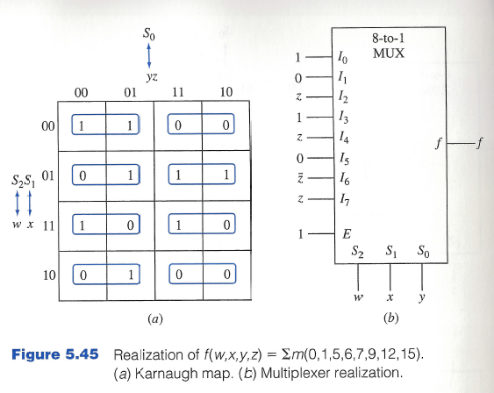
8-to-1-line multiplexers and 4-variable Boolean functions
Can do the same thing, three variables are placed on select lines, inputs to the data lines are single-variable functions.
Example:

Slide 24
Can we do better?
By allowing realizations of $m$-variable functions as inputs to the data input lines, $2^{n}$-to-1-line multiplexers can be used in the realization of $(n+m)$-variable functions.
E.g.: input variables w and x are applied to the $S_{1}, S_{0}$ select inputs. Functions of the y and z variables appear at the data input lines.

Slide 25
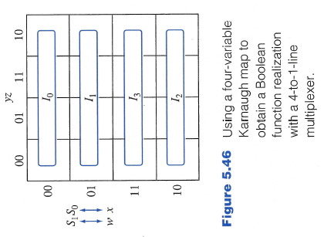
K-map Structure

Slide 26
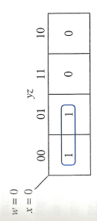
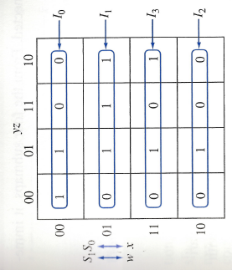
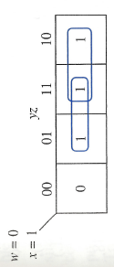
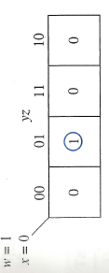
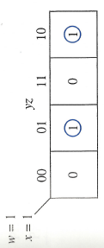
Example:
$$f\left(x,y,z\right)=∑m(0,1,5,6,7,9,13,14)$$

Slide 27
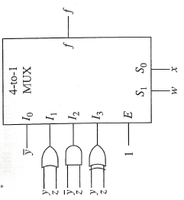
Example

Slide 28
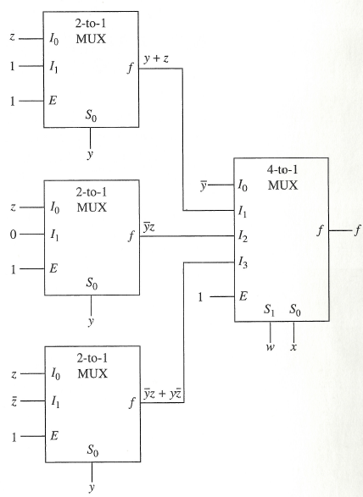
Example
Multiplexer Tree

Slide 29
Programmable Logic Devices (PLDs)
With the advent of large-scale integration technology, it has become feasible to fabricate large circuits within a single chip.
This has led to devices known as programmable logic devices (PLDs).
Programmable read-only memory (PROM)
Programmable logic array (PLA)
Programmable array logic (PAL)

Slide 30
General Structure of PLD
Inputs to the PLD are applied to a set of buffer/inverters. These devices have both the true value of the input as well as the complemented value of the input as its outputs.
Outputs from these devices are the inputs to an array of and-gates. The AND array generates a set of p product terms.
The product terms are inputs to an array of or-gates to realize a set of m sum-of-product expressions.

Slide 31
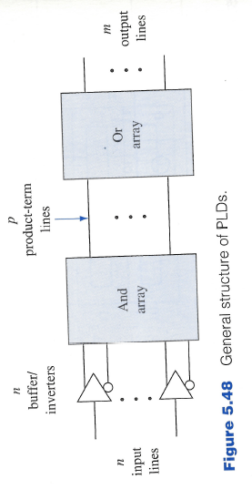
General Structure of PLD

Slide 32
General Structure of PLD
One or both of the gate arrays are programmable.
The logic designer can specify the connections within an array.
PLDs serve as general circuits for the realization of a set of Boolean functions.
Device | AND-array | OR-array
PROM | Fixed | Programmable
PLA | Programmable | Programmable
PAL | Programmable | Fixed

Slide 33
Programming a PLD
In a programmable array, the connections to each gate can be modified.
Simple approach is to have each of the gate inputs connected to a fuse.
Gate realizes the product term $abcd.$
To generate the product term $bc$ we remove the $a,d$ connections by blowing the corresponding fuses.
Thus, programming is a hardware procedure. Specialized equipment called programmers is needed to carry out the programming of a PLD.

Slide 34
Programming a PLD
Erasable PLD—connections can be reset to their original conditions and then reprogrammed.
Can be achieved by exposing the PLD to ultraviolet light or using electrical signals
PLDs programmed by a user are called field programmable.
User can also specify the desired connections and supply the information to the manufacturer. Manufacturer prepares an overlay that is used to complete the connections as the last step in the fabrication process.
Such PLDs are called mask programmable.

Slide 35
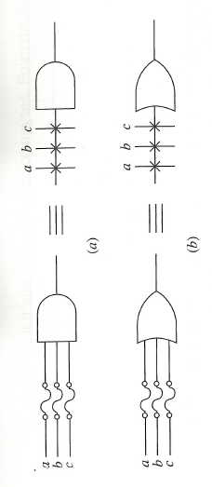
PLD Notation
Simplified notation. Each gate has only a single input line.
Inputs are indicated by lines at right angles to the single gate lines.
A cross at the intersection denotes a fusible link is intact.

Slide 36
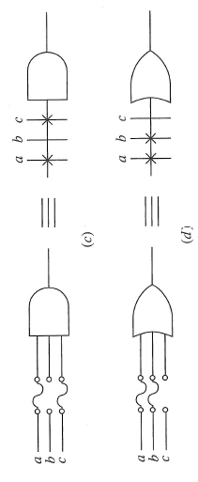
PLD Notation
Lack of cross indicates the fuse is blown or no connection exists.

Slide 37
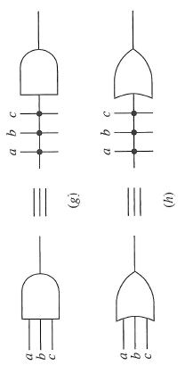
PLD Notation
The occurrence of a hard-wired connection that is not fusible is indicated by a junction dot.
For the special case when all the input fuses to a gate are kept intact, a cross is placed inside the gate symbol.

