Slide 1
Digital Logic Design
Lecture 21

Slide 2
Announcements
Homework 7 due on Thursday, 11/13
Recitation quiz on Monday on material from Lectures 21,22

Slide 3
Agenda
Last time:
Multiplexers (5.6)
This time:
Programmable Logic Devices (5.7)
Programmable Read-Only Memories (PROM) (5.8)
Programmable Logic Arrays (PLAs) (5.9)
Programmable Array Logic (PAL) (5.10)

Slide 4
General Structure of PLD
Inputs to the PLD are applied to a set of buffer/inverters. These devices have both the true value of the input as well as the complemented value of the input as its outputs.
Outputs from these devices are the inputs to an array of and-gates. The AND array generates a set of p product terms.
The product terms are inputs to an array of or-gates to realize a set of m sum-of-product expressions.

Slide 5
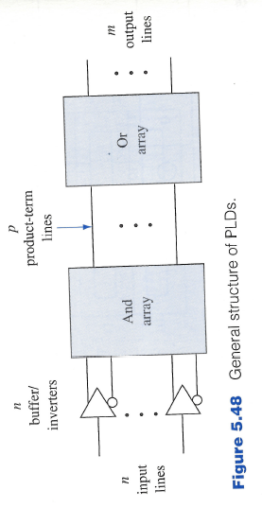
General Structure of PLD

Slide 6
General Structure of PLD
One or both of the gate arrays are programmable.
The logic designer can specify the connections within an array.
PLDs serve as general circuits for the realization of a set of Boolean functions.
Device | AND-array | OR-array
PROM | Fixed | Programmable
PLA | Programmable | Programmable
PAL | Programmable | Fixed

Slide 7
Programming a PLD
In a programmable array, the connections to each gate can be modified.
Simple approach is to have each of the gate inputs connected to a fuse.
Gate realizes the product term $abcd.$
To generate the product term $bc$ we remove the $a,d$ connections by blowing the corresponding fuses.
Thus, programming is a hardware procedure. Specialized equipment called programmers is needed to carry out the programming of a PLD.

Slide 8
Programming a PLD
Erasable PLD—connections can be reset to their original conditions and then reprogrammed.
Can be achieved by exposing the PLD to ultraviolet light or using electrical signals
PLDs programmed by a user are called field programmable.
User can also specify the desired connections and supply the information to the manufacturer. Manufacturer prepares an overlay that is used to complete the connections as the last step in the fabrication process.
Such PLDs are called mask programmable.

Slide 9
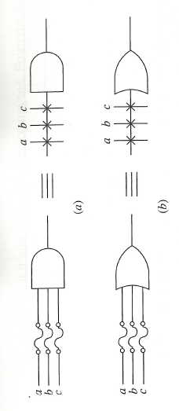
PLD Notation
Simplified notation. Each gate has only a single input line.
Inputs are indicated by lines at right angles to the single gate lines.
A cross at the intersection denotes a fusible link is intact.

Slide 10
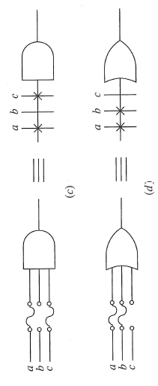
PLD Notation
Lack of cross indicates the fuse is blown or no connection exists.

Slide 11
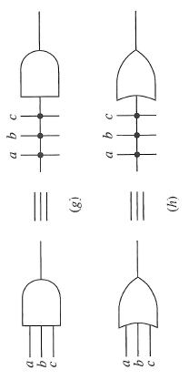
PLD Notation
The occurrence of a hard-wired connection that is not fusible is indicated by a junction dot.
For the special case when all the input fuses to a gate are kept intact, a cross is placed inside the gate symbol.

Slide 12
Programmable Read-Only Memory (PROM)
AND-array with buffer/inverter is an $n$-to-$2^{n}$-line decoder.
OR-array is a collection of programmable or-gates.
Decoder is a min-term generator.
n-variable minterms appear on the $2^{n}$ lines at the decoder output. These are also known as word lines.
n input lines called address lines, m output lines called bit lines.
$2^{n}×m$ PROM.
Realization of Boolean expressions same as realization using decoder discussed previously.

Slide 13
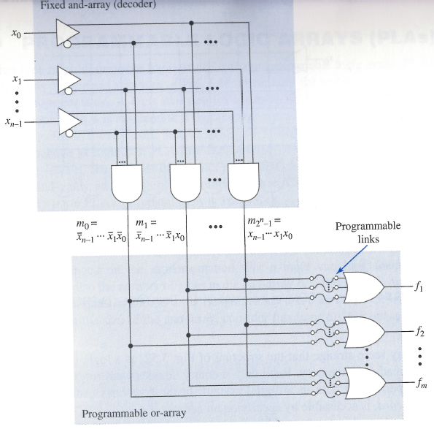
PROM Structure
Logic Diagram

Slide 14
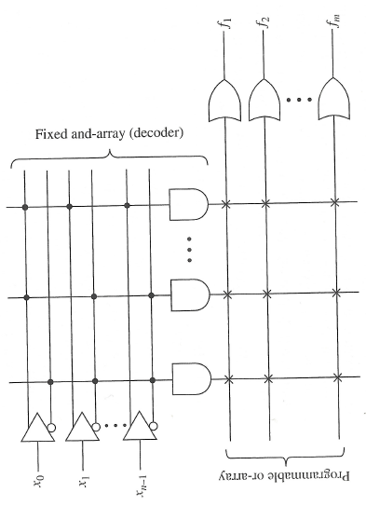
PROM Structure
PLD Notation

Slide 15
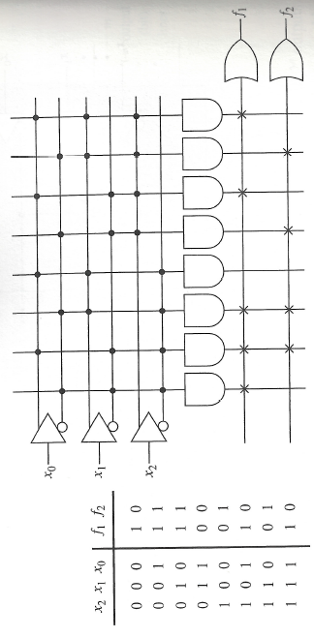
Example
Realizing $f_{1}\left(x_{2},x_{1},x_{0}\right)=∑m\left(0,1,2,5,7\right)$
$$f_{2}\left(x_{2},x_{1},x_{0}\right)=∑m(1,2,4,6)$$

Slide 16
Why is it called PROM?
3-bit input combination to the $x_{0},x_{1},x_{2}$ lines is regarded as an address of one of the word lines.
As a consequence of selecting a given word line, a pattern of 0’s and 1’s, a word, as determined by the fusible connections to the selected word line appears at the bit lines of the device.
This 0-1 pattern is considered the word stored at the address associated with the selected word line.
E.g. the word stored at address $x_{2}x_{1}x_{0}=100$ is $f_{1}f_{2}=01.$
“Read only”: The fact that the connections associated with the fusible links normally cannot be altered once they are formed.

Slide 17
Programmable Logic Array
PLAs are characterized by three numbers:
Number of input lines n
Number of product terms that can be generated p (the number of AND gates)
Number of output lines m
$n×p×m$ PLAs
Typical PLA is $16×48×8.$

Slide 18
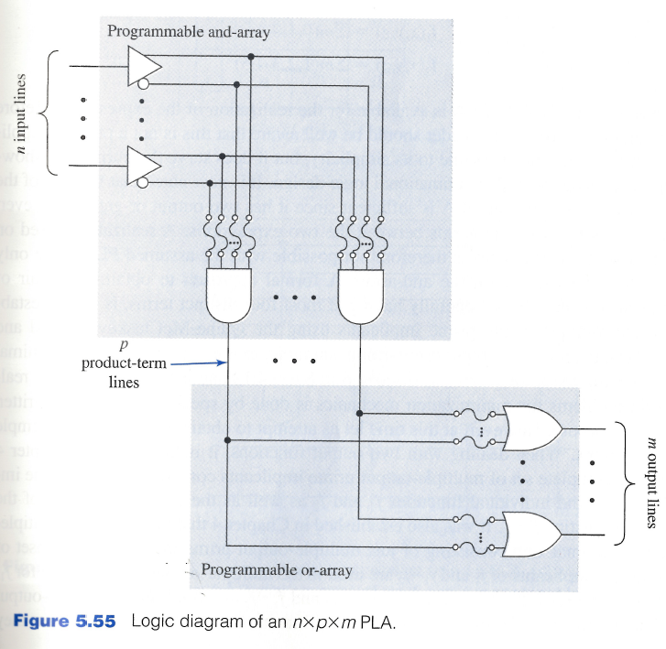
Programmable Logic Array

Slide 19
Programmable Logic Array
In many logic design situations not all the minterms are needed for a realization.
For $n$ input variables, $2^{n}$ minterms.
This is the number of gates in the AND-array of a PROM.
PLA’s with 16 input lines
$2^{16}=65,536$ minterms
In a $16×48×8$ PLA only 48 product terms.
$2n$ inputs appear at each AND gate.
For our examples, assume $3×4×2$ PLA.

Slide 20
PROM vs PLA
PROM: realization of a set of Boolean functions is based on minterm canonical expressions.
No minimization necessary.
PLA: the AND gates are capable of generating product terms that are not necessarily minterms.
Realization using PLA is based on sum-of-product expression that may not be canonical.
Logic designer is bounded by the number of product terms that are realizable by the AND-array.
Simplifications is necessary.

Slide 21
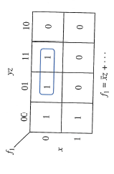
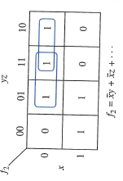
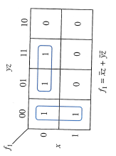
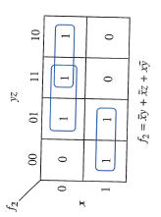
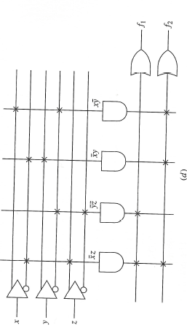
Logic Design Example
$$f_{1}$$
$$f_{2}$$
$${f_{1}⋅f}_{2}$$

Slide 22
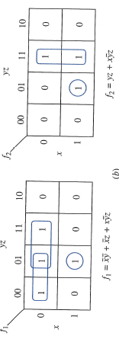
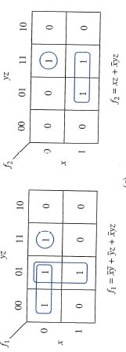
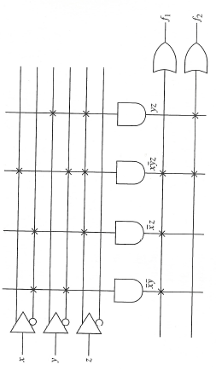
Logic Design Example
$$f_{1}$$
$$f_{2}$$
$${f_{1}⋅f}_{2}$$

Slide 23
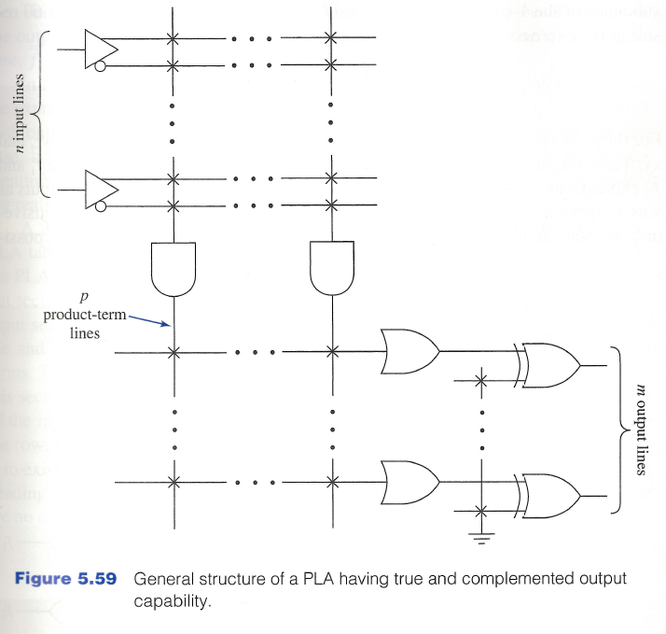
Additional Features
For greater flexibility, PLAs make provision for either a true output or a complemented output.
$f_{i}$ feeds into one input of an XOR gate. The other input is connected to a pull-up resistor.
When the fuse is left intact, the input is 0. When the fuse is blown, input is 1.

Slide 24
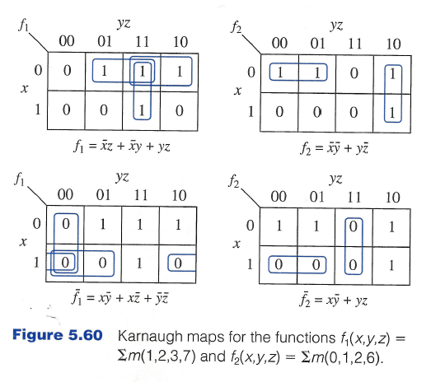
Example of Use of Complemented Functions

Slide 25
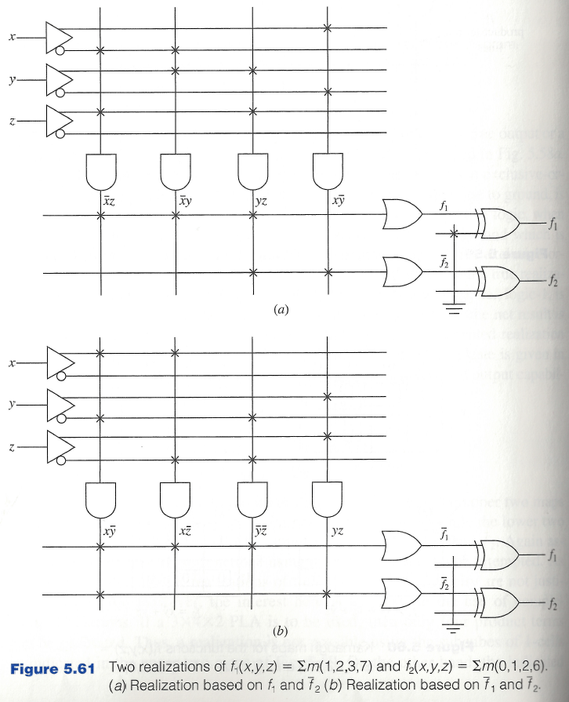
Example of Use of Complemented Functions

Slide 26
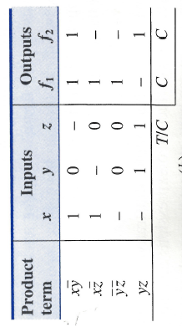
PLA Table
A common way of specifying the connections in a PLA.
3 sections: input section, output section, T/C section.
Each product term is assigned a row in the table.
Input section indicates connections between inputs to AND-array.
Output section indicates connections between outputs of AND-array and inputs to the OR-array.
T/C section indicates how the exclusive or gates are programmed.
T—true output is used.
C—output should be complemented.

Slide 27
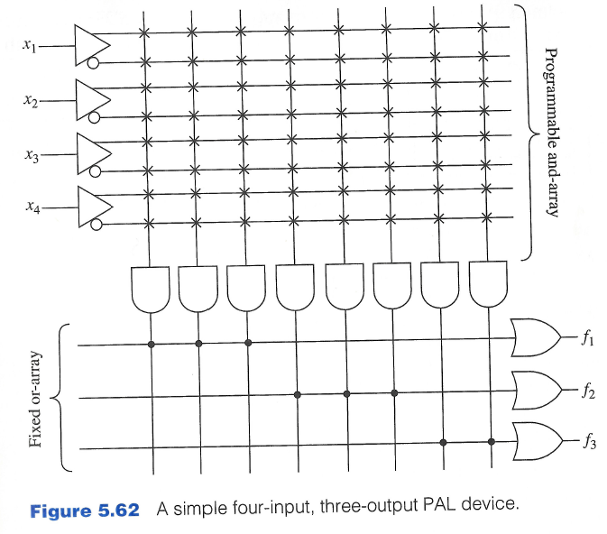
Programmable Array Logic (PAL) Devices
OR-array is fixed by the manufacturer of the device.
PAL device is easier to program and less expensive than the PLA.
Less flexible.
For our examples:
4-input, 3-output PAL device
Three Boolean expressions can be realized in which two expressions can have at most 3 product terms and one expression can have at most 2 product terms.

Slide 28
Example of Logic Design with PAL
Consider
$$f_{1}\left(x,y,z\right)=∑m\left(1,2,4,5,7\right)$$
$$f_{2}\left(x,y,z\right)=∑m\left(0,1,3,5,7\right)$$
Minimal sums:
$$f_{1}\left(x,y,z\right)=x\overline{y}+xz+\overline{y}z+\overline{x}y\overline{z}$$
$$f_{2}\left(x,y,z\right)=z+\overline{x} \overline{y}$$

Slide 29
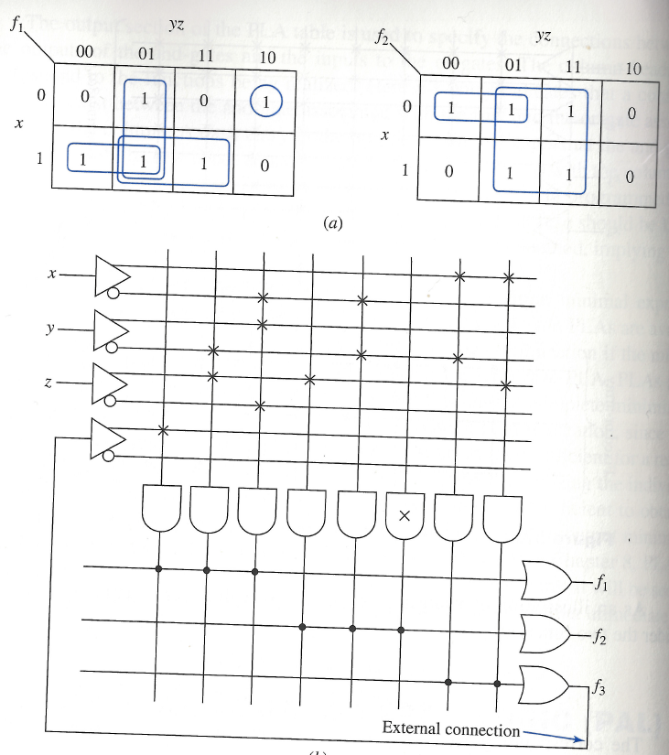
Example of Logic Design with PAL

