Slide 1
Digital Logic Design
Lecture 23

Slide 2
Announcements
Homework 8 due Thursday, 11/20
Exam 3 coming up on Tuesday, 11/25

Slide 3
Exam Topics
MSI Components: Binary adders/Subtracters, Carry Lookahead Adder, Large High-Speed Adders, Decimal Adders, Comparators, Decoders, Logic Design Using Decoders, Decoders with enable input, Encoders, Multiplexers, Logic Design with Multiplexers.
Programmable Logic Devices: PLD Notation, PROM, PLA, PAL.
Flip-Flops: The Basic Bistable Element, Latches, SR Latch, $\overline{S} \overline{R}$ Latch, Gated SR Latch, Gated D Latch, Timing Considerations, Propagation Delays, Minimum Pulse Width, Setup and Hold times.
Today’s Lecture: Master-Slave Flip-Flops, Master-Slave SR Flip-Flop, Master-Slave JK Flip-Flop, 0’s and 1’s Catching, Edge-Triggered Flip-Flops, Edge-Triggered D-Flip-Flop, Negative-Edge Triggered D Flip Flops, Positive edge triggered T flip-flop, Characteristic Equations, Registers, Counters.
**Will determine final list of exam topics after today’s lecture.

Slide 4
Agenda
Last time:
The Basic Bistable Element (6.1)
Latches (6.2)
Timing Considerations (6.3)
This time:
Master-Slave Flip-Flops (6.4)
Edge-Triggered Flip-Flops (6.5)
Characteristic Equations (6.6)
Registers (6.7)
Counters (6.8)

Slide 5
Master-Slave Flip-Flops (Pulse Triggered Flip-Flops)
Aside from latches, two categories of flip-flops.
Master-slave flip-flops (pulse-triggered flip-flops)
Edge-triggered flip-flops
Latches have immediate output response (known as transparency)
May be undesirable:
May be necessary to sense the current state of a flip-flop while allowing new state information to be entered.

Slide 6
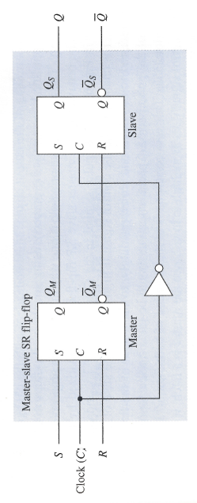
Master-Slave SR Flip-Flop
Two sections, each capable of storing a binary symbol.
First section is referred to as the master and the second section as the slave.
Information is entered into the master on one edge or level of a control signal and is transferred to the slave on the next edge or level of the control signal.
Each section is a latch.

Slide 7
Master-Slave SR Flip-Flop
C = 0:
Master is disabled. Any changes to S,R ignored.
Slave is enabled. Is in the same state as the master.
C = 1:
Slave is disabled (retains state of master)
Master is enabled, responds to inputs. Changes in state of master are not reflected in disabled slave.
C = 0:
Master is disabled.
Slave is enabled and takes on new state of the master.
Important: For short periods during rising and falling edges, both master and slave are disabled.

Slide 8
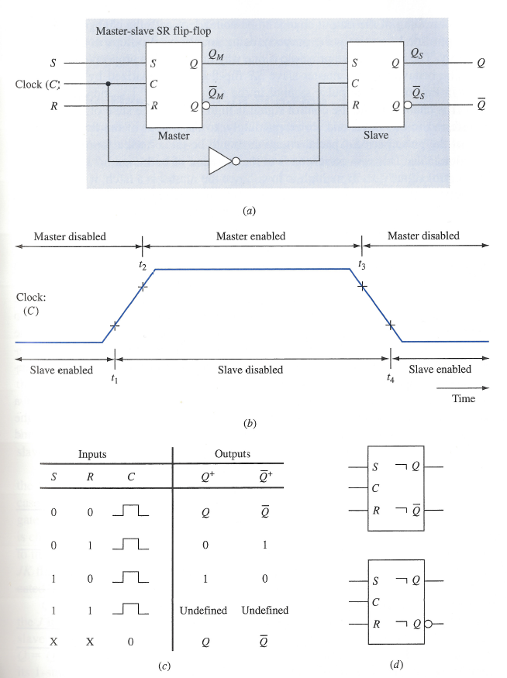
Master-Slave SR Flip-Flop
Slave only takes on state of the master at $t_{4}.$
Pulse symbol indicates master enabled when C = 1 and state of master transferred to slave at the end of the pulse period.
Postponed output indicator: output change postponed until end of pulse
If S, R = 1 when control signal goes from high to low we are in an unpredicable state. Can cause metastable state.

Slide 9
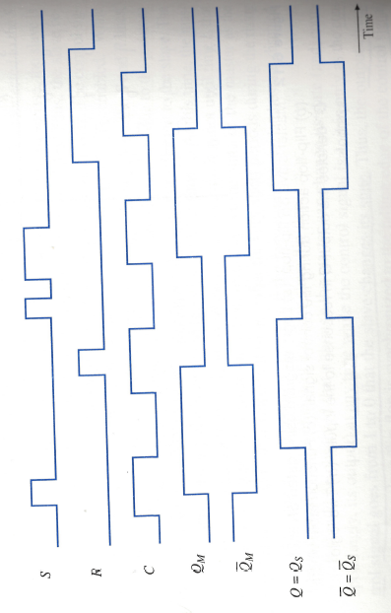
Timing Diagram for Master-Slave SR flip-flop

Slide 10
Master-Slave JK Flip-Flop
The output state of a master-slave SR flip-flop is undefined upon returning the control input to 0 when S = R = 1.
Necessary to avoid this condition.
Master-slave JK flip-flop allows its two information input lines to be simultaneously 1.
Results in toggling the output of the flip flop.

Slide 11
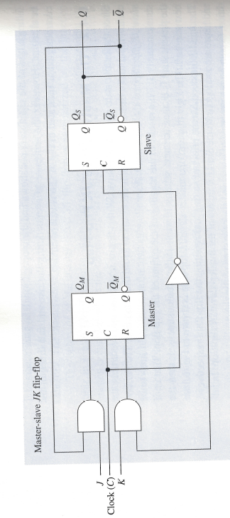
Master-Slave JK Flip-Flop
Assume in 1-state, C = 0, J = K = 1.
Due to feedback, the output of the J-gate is 0, output of K-gate is 1.
If clock is changed to C = 1 then master is reset.
Assume in 0-state, C = 0, J = K = 1.
Due to feedback, the output of the J-gate is 1, output of K-gate is 0.
If clock is changed to C = 1 then master is set.
1 on J input line, 0 on K input line sets the flip-flop.
If in 1-state, unchanged b/c S,R set to 0.
If in 0-state, S set to 1, R set to 0.
0 on J input, 1 on K input line resets the flip-flop. Why?

Slide 12
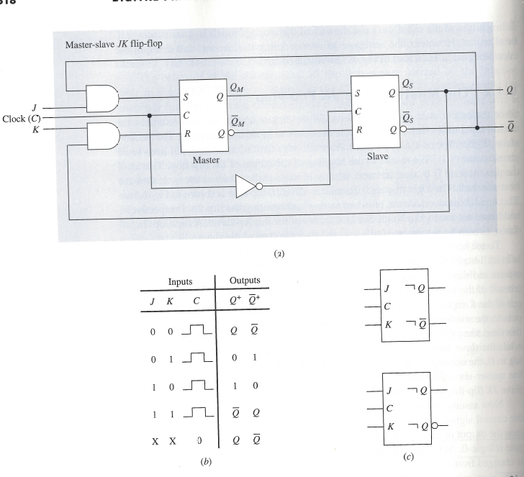
Master-Slave JK Flip-Flop

Slide 13
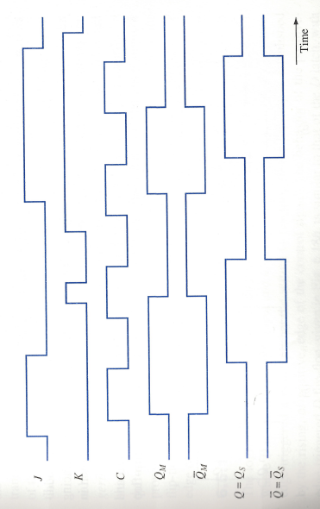
Timing Diagram for Master-Slave JK Flip-Flop

Slide 14
0’s and 1’s Catching
The master is enabled during the entire period the control-signal is 1.
If the slave latch is in its 1-state, then a logic-1 on K-input line causes the master-latch to reset. Slave becomes reset when control signal returns to 0.
This is known as 0’s catching (2nd pulse).
Note: if a subsequent 1-signal on J input line and C is still 1, master does not become set again (due to feedback not changing).
If slave latch is in 0-state, logic-1 on J input line while control signal is 1 causes the master latch to be set and slave will be set upon occurrence of the falling edge.
This is known as 1’s catching (3rd pulse).
In many applications, 0’s and 1’s catching behavior is undesirable. Normally recommended that the J and K input values should be held fixed during the entire interval the master is enabled.
Any changes in J, K must occur while the control signal is 0.

Slide 15
0’s Catching
Assume in 1-state $\left(Q=1, \overline{Q}=0\right), C=1, J=0, K=0$
$K$ gets set to 1 briefly.
Master gets reset, Slave will become reset when Clock goes to 0.
$K$ goes to 0.
$J$ goes to 1. What happens?
Nothing! Slave will still become reset when Clock goes to 0.
Why?

Slide 16
Edge-Triggered Flip-Flops
In basic master-slave flip-flops, master is enabled during the entire period the control input is 1.
This can result in 0’s and 1’s catching.
To avoid this, signals on information lines are restricted from changing during the time the master is enabled.
Also a delay in the output since master’s state is established during the positive edge and transferred to the slave on the negative edge of clock.
Edge-triggered flip-flops use just one of the edges of the clock signal.
This is referred to as the triggering edge.
Response to triggering edge at the output of the flip-flop is almost immediate (depends only on propagation delay times).
Once triggering occurs, flip-flop is unresponsive to information input changes until the next triggering edge.

Slide 17
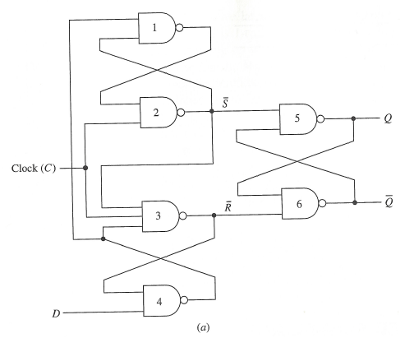
Edge-Triggered Flip-Flops
C = 0. Regardless of input at D, outputs of gates 2,3 are 1. So $\overline{S}=\overline{R}=1.$ State of latch is held.
Assume D = 0: Output of gate 4 is 1, output of gate 1 is 0. When C goes to 1: all inputs to gate 3 are 1, output changes to 0. Output of gate 2 remains at 1 since output of gate 1 is 0. So $\overline{S}=1,\overline{R}=0$. Output of gate 3 (0) is fed to input of gate 4. Output of gate 4, gate 1 not affected by changes to D.
Assume C = 0, D = 1. Outputs of gates 2,3, are 1. Output of gate 4 is 0, output of gate 1 is 1. When C goes to 1: output of gate 2 is 0, output of gate 3 remains at 1. So $\overline{S}=0,\overline{R}=1$. Output from gate 2 is input to gates 1, 3 so their outputs remain at 1. Changes in D have no affect on state of flip-flop while C = 1.
$\overline{S} \overline{R}$ Latch

Slide 18
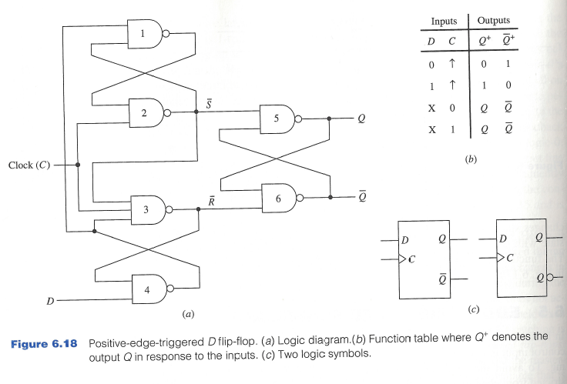
Edge-Triggered Flip-Flops

Slide 19
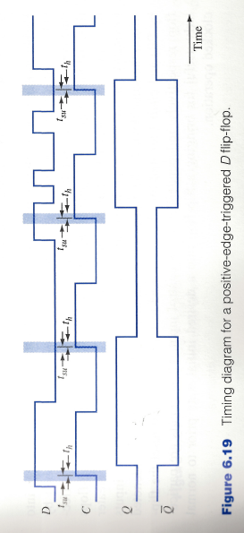
Timing Diagram
During setup and hold times $t_{su}, t_{h}$ with respect to the triggering edge of the clock, D input must not change.

Slide 20
Negative-Edge Triggered D Flip-Flop
A falling edge (high to low transition) of control signal is used to sample the D input line.
Simply place inverter at the control input of the flip-flop.

Slide 21
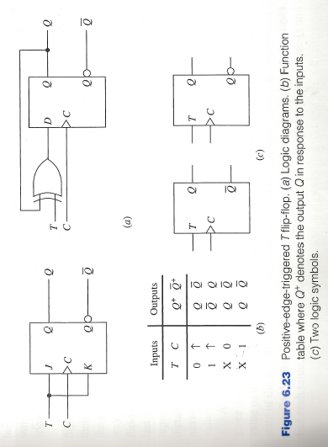
Positive-Edge Triggered T-Flip-Flop

Slide 22
Characteristic Equations
Next state table: Shows the value of the next state of the flip-flop for each combination of values to the present state of the flip-flops and their information lines.
The algebraic description of the next-state table of a flip-flop is called the characteristic equation of the flip-flop.
Obtained by constructing the K-map for $Q^{+}$ in terms of the present state and information input variables.

Slide 23
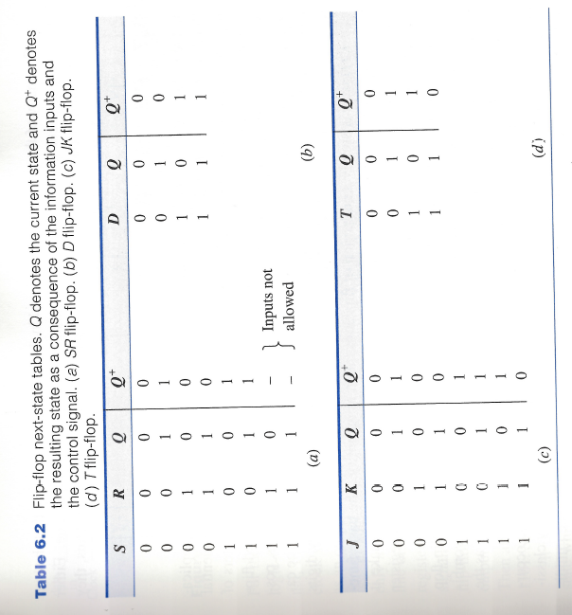
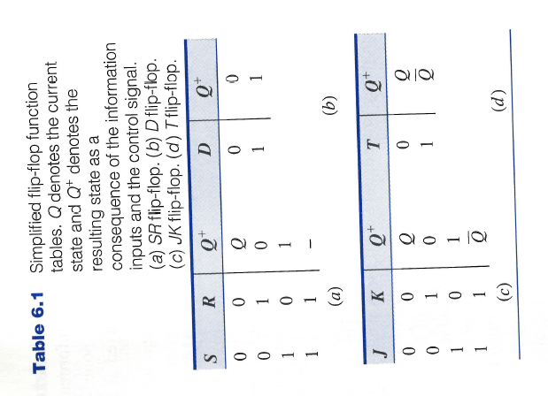
Next State Tables

Slide 24
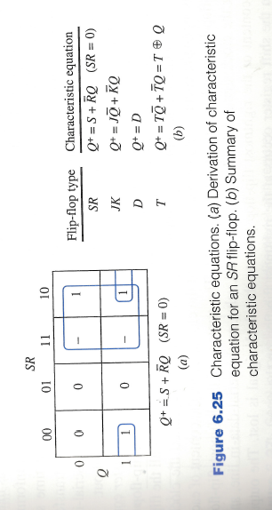
Characteristic Equations

Slide 25
Registers
A collection of flip-flops taken as an entity.
Function: Hold information within a digital system so that it is available to the logic elements during the computing process.
Each combination of stored information is known as the state or content of the register.
Shift register: Registers that are capable of moving information upon the occurrence of a clock-signal.
Unidirectional
bidirectional

Slide 26
Registers
Two basic ways in which information can be entered/outputted
Parallel: All 0/1 symbols handled simultaneously. Require as many lines as symbols being transferred.
Serial: Involves the symbol-by-symbol availability of information in a time sequence.
Four possible ways registers can transfer information:
Serial-in/serial-out
Serial-in/parallel-out
Parallel-in/parallel-out
Parallel-in/serial-out

