Slide 1
Digital Logic Design
Lecture 24

Slide 2
Announcements
Homework 8 due today
Exam 3 on Tuesday, 11/25.
Topics for exam are up on the course webpage.

Slide 3
Agenda
Last time:
Master-Slave Flip-Flops (6.4)
Edge-Triggered Flip-Flops (6.5)
Characteristic Equations (6.6)
This time:
Registers (6.7)
Counters (6.8-6.9)
Review

Slide 4
Registers
A collection of flip-flops taken as an entity.
Function: Hold information within a digital system so that it is available to the logic elements during the computing process.
Each combination of stored information is known as the state or content of the register.
Shift register: Registers that are capable of moving information upon the occurrence of a clock-signal.
Unidirectional
bidirectional

Slide 5
Registers
Two basic ways in which information can be entered/outputted
Parallel: All 0/1 symbols handled simultaneously. Require as many lines as symbols being transferred.
Serial: Involves the symbol-by-symbol availability of information in a time sequence.
Four possible ways registers can transfer information:
Serial-in/serial-out
Serial-in/parallel-out
Parallel-in/parallel-out
Parallel-in/serial-out

Slide 6
Serial-in, Serial-out, Unidirectional Shift Register

Slide 7
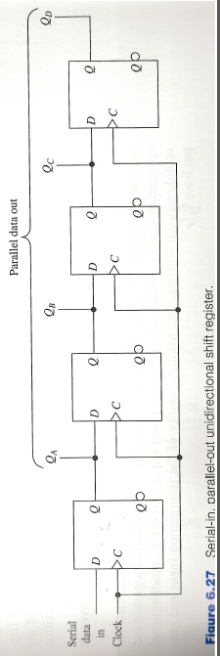
Serial-in, Parallel-out Unidirectional Shift Register

Slide 8
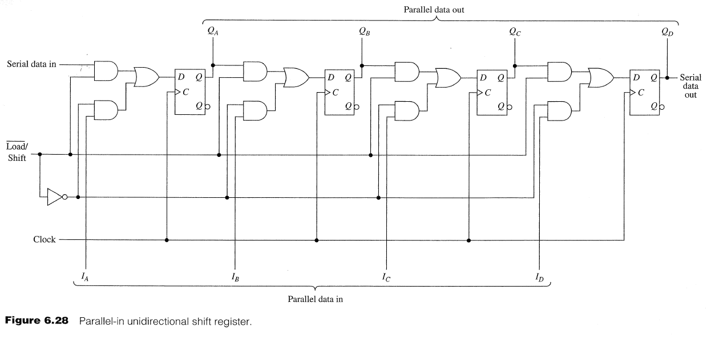
Parallel-in, Parallel-out Unidirectional Shift Register

Slide 9
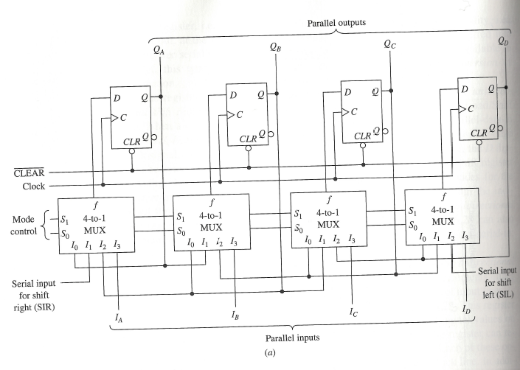
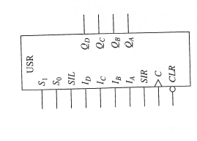
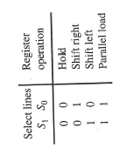
Universal Shift Register
A bidirectional shift register. Capable of shifting contents either left or right depending upon the signals present on appropriate control input lines.
Universal shift register: Depending on the signal values on the select lines of the multiplexers, the register can retain its current state, shift right, shift left or be loaded in parallel. Each operation is the result of a positive edge on the clock line.

Slide 10
Counters
An example of a register.
Primary purpose is to produce a specified output pattern sequence.
Also called a pattern generator
Each stored 0/1 combination is called the state of the counter.
The total number of states is called its modulus.
If a counter has m distinct states then it is called a mod-m counter.
The order in which states appear is referred to as its counting sequence.
Depicted by a directed graph called a state diagram.

Slide 11
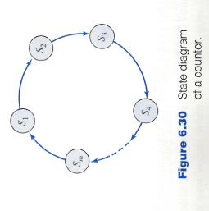
State Diagram of a Counter
$S_{i}$ denotes one of the states of the counter.
Arrows in the graph denote the order in which the states occur.

Slide 12
Binary Ripple Counters
Counters whose counting sequence corresponds to that of the binary numbers are called binary counters.
Modulus is $2^{n}$, where $n$ is the number of flip-flops in the counter.
Binary up-counter, binary down-counter

Slide 13
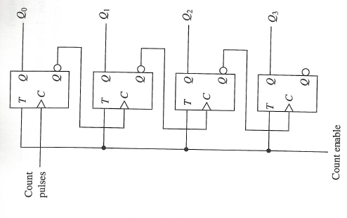
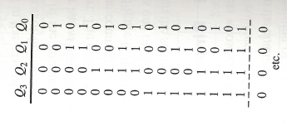
4-bit Binary Ripple Counter
Recall positive edge-triggered T-Flip-Flop.
Each positive transition from logic-0 to logic-1 causes the flip-flop to toggle.

Slide 14
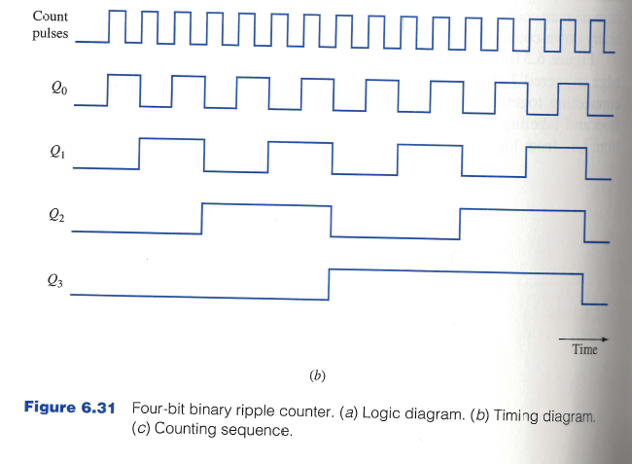
4-bit Binary Ripple Counter

Slide 15
4-bit Binary Ripple Counter
Known as a ripple counter since a change in the state of the $Q_{i−1}$flip-flop is used to toggle the $Q_{i}$ flip-flop.
The effect of a count pulse must ripple through the counter.
Ripple counters also referred to as asynchronous counters.
Propagation Delay
There is a propagation delay between the input and output of a flip-flop.
Rippling behavior affects the overall time delay between the occurrence of a count pulse and when the stabilized count appears at the output terminals.
Worst Case?
Going from $111⋯111$ to $000⋯000$ since toggle signals must propagate through the entire length of the counter.
For n-stage binary ripple counter, the worst case time is $n⋅t_{pd}$, where $t_{pd}$ is the propagation delay time associated with each flip-flop.

Slide 16
Synchronous Binary Counters
All flip-flops change simultaneously after the appropriate propagation delay associated with a single flip-flop.
Count pulses are applied directly to the control inputs, C, of all the clocked flip-flops.
All flip-flops change simultaneously after the appropriate propagation delay associated with a single flip-flop.

Slide 17
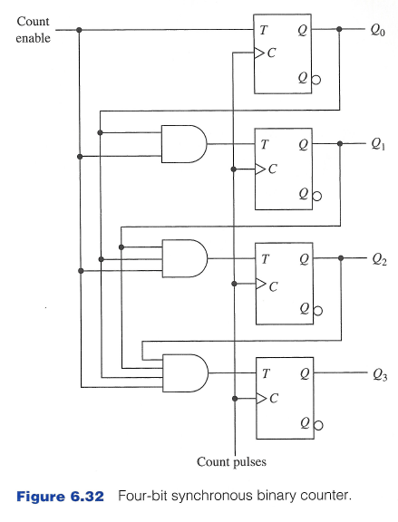
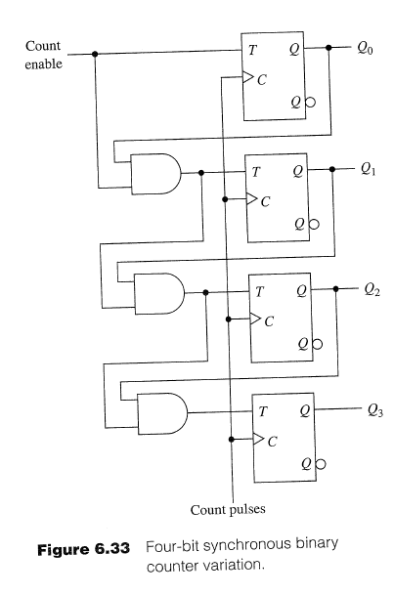
Synchronous Binary Counters
The and gate preceding each input T detects if all lower-order bits are in 1-state. If yes, toggles on positive clock edge.
Drawback: And gates have many inputs.
Output of AND gate preceding the $i$th flip flop consists of the inputs fo the and-gate preceding the $i−1$^{st} flip-flop and the output $Q_{i−1}.$

Slide 18
Mod-m Counter
Use a mod-$2^{n}$ counter as a mod-$m$ counter.
Load an initial binary number prior to the counting operation.
Counter structure is modified to allow for parallel loading.
JK flip-flops are used instead of T flip-flops.
Two enable signals:
Load enable: Allows parallel loading of data inputs $D_{0}, D_{1}, D_{2}, D_{3}$
Count enable: allows for counting.

Slide 19
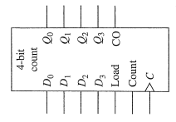
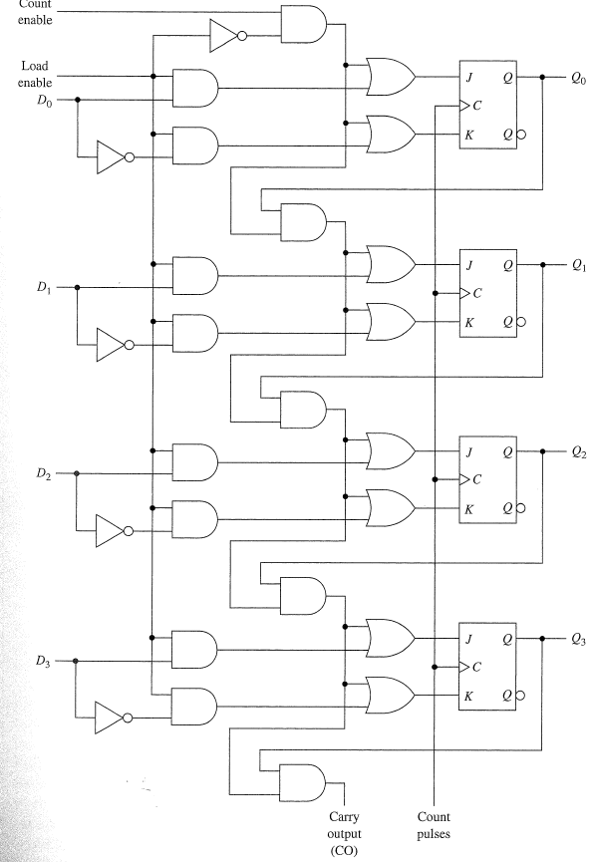
Mod-m Counter
JK flip-flops are used. Two enable signals: One to allow parallel loading of the data inputs $D_{0}, D_{1}, D_{2},D_{3}$ and a second for counting. Operations synchronized with positive edges of the count pulses. The load function takes precedence over the count function (due to NOT-gate connected to the load enable line).

Slide 20
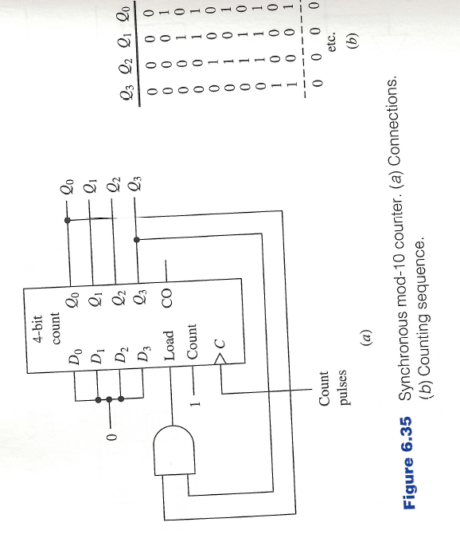
Mod-10 Counter

Slide 21
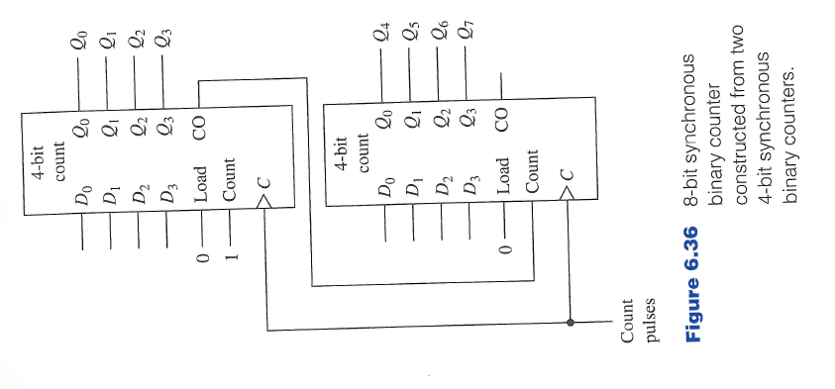
8-bit Counter
Building an 8-bit counter from 2 4-bit counters.

Slide 22
Counters Based on Shift Registers
Ring counter. Not efficient in the number of flip-flops used, but provides a decoded output. To detect any particular state in the counting sequence it is only necessary to interrogate the output of a single flip-flop.

Slide 23
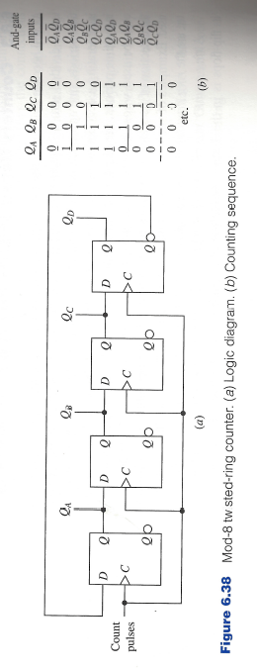
Counters Based on Shift Registers
Twisted ring counter. The complement of the rightmost flip-flop serves as the input to the leftmost flip-flop. $2n$ states occur in the counting sequence of an $n$-stage counter.
Underlined pairs of bits uniquely determine a state. A single two-input and-gate is required to obtain a decoded output.
Always has even number of states.

Slide 24
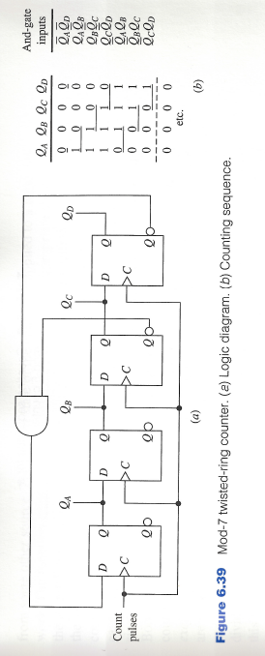
Counters Based on Shift Registers
Twisted ring counter for odd number of states. The state consisting of all 1’s is eliminated from the counting sequence. Achieved by connecting ${\overline{Q}}_{C}{\overline{Q}}_{D}$ to the input of the leftmost D flip-flop.
Each state is detectable by use of a single two-input and-gate.

