Slide 1
Digital Logic Design
Lecture 26

Slide 2
Announcements
Exams will be returned on Thursday
Final small quiz on Monday, 12/8.
Final homework will be assigned Thursday, 12/4. Due on the last day of class (Thursday, 12/11).
Note on number of quizzes and exams
Please fill out course evaluations online
Your feedback is essential!!

Slide 3
Agenda
New topic: Synchronous Sequential Networks
Structure and Operation of Clocked Synchronous Sequential Networks (7.1)
Analysis of Clocked Synchronous Sequential Networks (7.2)
Modeling Clocked Synchronous Sequential Network Behavior (7.3)

Slide 4
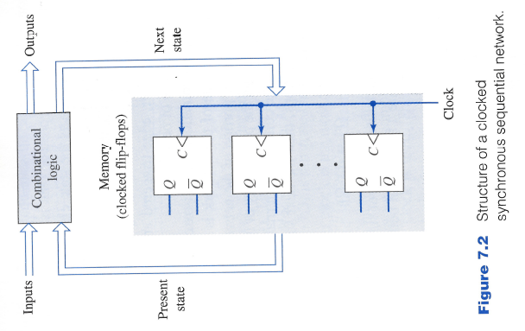
Clocked Synchronous Sequential Networks
Network behavior is defined at specific instants of time associated with a clock signal.
Usually a master clock that appears at the control inputs of all the flip-flops.
Combinational logic is used to generate the next-state and output signals.

Slide 5
Clocked Synchronous Sequential Networks
Input and new present state signals are applied to the combinational logic.
Effects of the signals must propagate through the network.
Final values at the flip-flop inputs occur at different times depending upon the number of gates involved in the signal paths.
Only after final values are reached, active time of the clock signal is allowed to occur and cause any state changes.
All state changes of the flip-flops occur at the same time.

Slide 6
Clocked Synchronous Sequential Networks
Next state of the network: $Q^{+}=f\left(X,Q\right)$
$X$ denotes the collective external input signals
$Q$ denotes the collective present states of the flip-flops.
$Z$ denotes the collective output signals of the network: $Z=g\left(X,Q\right).$

Slide 7
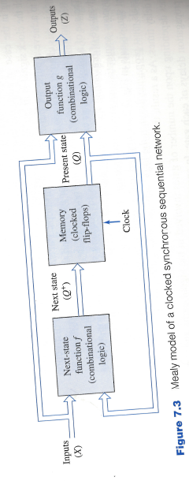
Mealy model
The general structure of a clocked synchronous sequential network.

Slide 8
Moore Model
Variation of Mealy model when the outputs are only a function of the present state and not of the external inputs: $Z=g(Q)$.

Slide 9
Analysis of clocked Synchronous Sequential Network

Slide 10
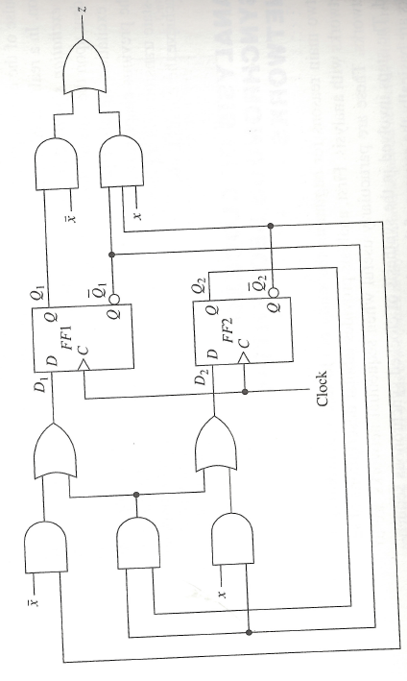
Two Examples
Figure 1: Mealy network

Slide 11
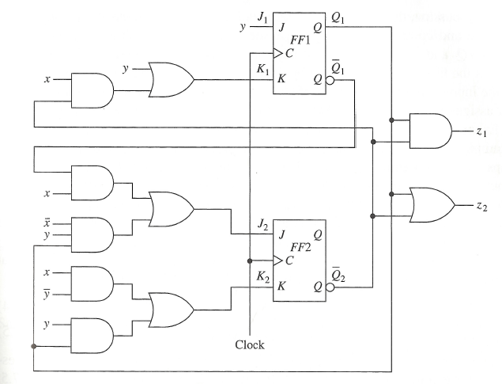
Two Examples
Figure 2: Moore network

Slide 12
Excitation and Output Expressions
Assign variables to flip flop-states $Q_{1}, {\overline{Q}}_{1}, Q_{2}, {\overline{Q}}_{2}$
Assign excitation variables to flip-flop inputs $D_{1}, D_{2}, J_{1}, K_{1}, J_{2}, K_{2}$
Excitation and output expressions for Fig. 1:
$D_{1}=\overline{x}{\overline{Q}}_{2}+{\overline{Q}}_{1}Q_{2}$
$D_{2}=x{\overline{Q}}_{1}+{\overline{Q}}_{1}Q_{2}$
$z=\overline{x}Q_{1}+x{\overline{Q}}_{1}{\overline{Q}}_{2}$
Excitation and output expressions for Fig 2:
$J_{1}=y$
$K_{1}=y+x{\overline{Q}}_{2}$
$J_{2}=x{\overline{Q}}_{1}+\overline{x}yQ_{1}$
$K_{2}=x\overline{y}+yQ_{1}$
$z_{1}=Q_{1}{\overline{Q}}_{2}$
$z_{2}=Q_{1}+{\overline{Q}}_{2}$

Slide 13
Transition Equations
Transition Equations for Figure 1:
${Q_{}^{+}}_{1}=D_{1}$
${Q_{}^{+}}_{2}=D_{2}$
${Q_{}^{+}}_{1}$= $\overline{x}{\overline{Q}}_{2}+{\overline{Q}}_{1}Q_{2}$
${Q_{}^{+}}_{2}$ = $x{\overline{Q}}_{1}+{\overline{Q}}_{1}Q_{2}$
Transition Equations for Figure 2:
${Q_{}^{+}}_{1}=J_{1}{\overline{Q}}_{1}+{\overline{K}}_{1}Q_{1}$
${Q_{}^{+}}_{2}=J_{2}{\overline{Q}}_{2}+{\overline{K}}_{2}Q_{2}$
${Q_{}^{+}}_{1}=y{\overline{Q}}_{1}+\overline{\left(y+x{\overline{Q}}_{2}\right)}Q_{1}=y{\overline{Q}}_{1}+\overline{x} \overline{y}Q_{1}+\overline{y}Q_{1}Q_{2}$
${Q_{}^{+}}_{2}=\left(x{\overline{Q}}_{1}+\overline{x}yQ_{1}\right){\overline{Q}}_{2}+\overline{\left(x\overline{y}+yQ_{1}\right)}Q_{2}=x{\overline{Q}}_{1}{\overline{Q}}_{2}+\overline{x}yQ_{1}{\overline{Q}}_{2}+\overline{x} \overline{y}Q_{2}+\overline{x}{\overline{Q}}_{1}Q_{2}+y{\overline{Q}}_{1}Q_{2}$

Slide 14
Transition Tables
Rather than using algebraic descriptions can express the information in tabular form.
Table consists of three sections
Present state variables
Next-state variables
Output variables
Present state variables:
Lists all the possible combinations of values for the state variables.
If there are $p$ state variables, then $2^{p}$rows.
Next-state section
One column for each combination of values of the external input variables.
If there are $n$ external input variables, then $2^{n}$ columns.
Each entry is a $p$-tuple corresponding to the next state for each combination of present state and external input.
Mealy network outputs:
One column for each combination of values of the external input variables.
Entries within the section indicate the outputs for each present-state/input combination.
Moore network outputs:
Output section has only a single column.

Slide 15
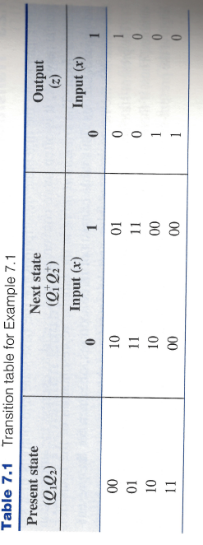
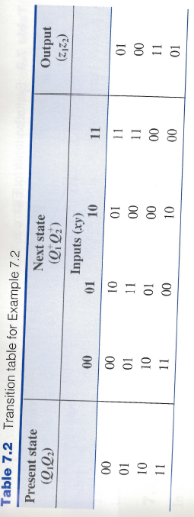
Transition Tables

Slide 16
Excitation Tables
The transition table is constructed as the result of substituting excitation expressions into the flip-flop characteristic equations.
An alternative approach:
First construct the excitation table directly from the excitation and output expressions.
Excitation table consists of three parts:
Present-state section
Excitation section
Output section

Slide 17
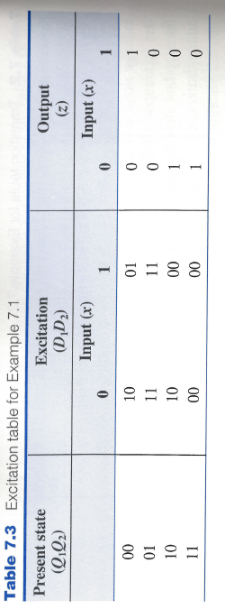
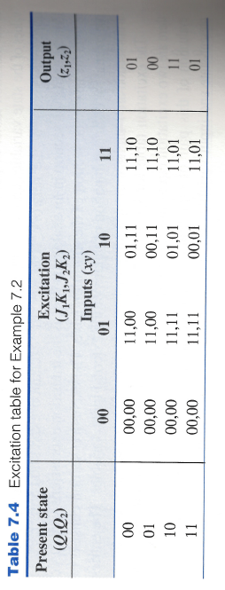
Excitation Tables

Slide 18
Constructing Transition Tables from Excitation Tables
Consider entry in fourth column, first row of second table:
$J_{1}K_{1}, J_{2}K_{2}=11,10$
Present state: $Q_{1}Q_{2}=00$
So due to behavior of JK-flip-flop next state is: ${Q_{}^{+}}_{1}=1, {Q_{}^{+}}_{2}=1.$

Slide 19
State Tables
State table consists of three sections:
Present state
Next state
Output
Actual binary codes used to represent the states are not important.
Alphanumeric symbols can be assigned to represent these states.
State table is essentially a relabeling of the transition table.

Slide 20
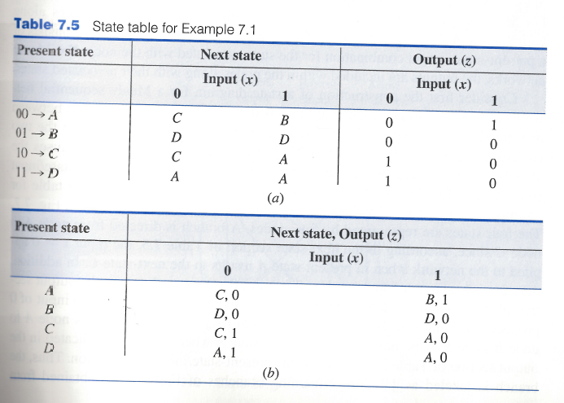
State Tables

Slide 21
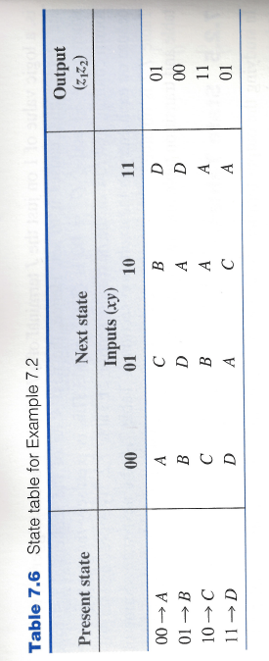
State Tables

Slide 22
State Diagrams
Graphical representation of the state table.
Each state is represented by a labeled node.
Directed branches connect the nodes to indicate transitions between states.
Directed branches are labeled according to the values of the external input variables.
Outputs of the sequential network are also entered on a state diagram.
Mealy network:
Outputs appear on the directed branches along with the external inputs.
Moore network:
Outputs are included within the nodes along with their associated states.

Slide 23
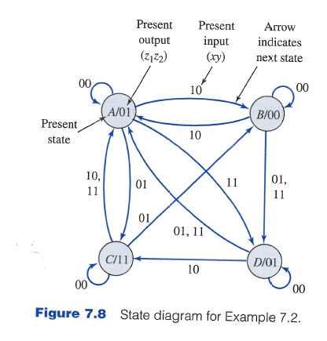
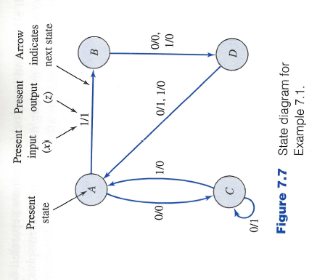
State Diagrams

Slide 24
Network Terminal Behavior
Consider example from Figure 1:
Assume flip-flops are both in 0-states (state A)
Input sequence $x=0011011101$ is applied
Note: For mealy sequential network, although outputs are shown on directed branches, this does not mean that the outputs are produced during the transition.
Outputs appearing on the branches are continuously available while in a present state and the indicated inputs are applied.
Input sequence $x$ | = | 0 | 0 | 1 | 1 | 0 | 1 | 1 | 1 | 0 | 1
State sequence | = | A | C | C | A | B | D | A | B | D | A | B
Output sequence $z$ | = | 0 | 1 | 0 | 1 | 0 | 0 | 1 | 0 | 1 | 1

Slide 25
False Outputs in a Mealy network
The values of the external input variables may change at any time during the clock period.
Although these input changes can continuously affect the network outpus, the consequences of these input changes do not appear in the listing of the output sequence.

Slide 26
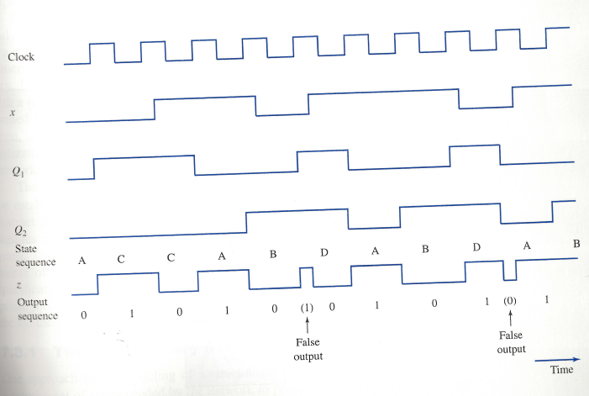
Timing Diagrams to Illustrate False Outputs

