Slide 1
Digital Logic Design
Lecture 27

Slide 2
Announcements
Exams returned at end of lecture
Homework 9 is up, due Thursday, 12/11
Recitation quiz on Monday, 12/8
Will cover material from Lectures 26, 27

Slide 3
Agenda
Last time:
Structure and Operation of Clocked Synchronous Sequential Networks (7.1)
Analysis of Clocked Synchronous Sequential Networks (7.2)
This time:
Modeling Clocked Synchronous Sequential Network Behavior (7.3)
State Table Reduction (7.4)

Slide 4
Modeling clocked synchronous sequential network behavior
Approach for the synthesis of clocked synchronous sequential networks:
State table/state diagram is constructed from word specifications.
State reduction technique to obtain a state table with minimum number of states.
Transition table is formed by coding the states of the state table.
Excitation table is constructed based on the flip-flop types to be used.
From the excitation table, the excitation and output expressions for the network are determined.
Finally, the logic diagram is drawn.

Slide 5
Examples of Modeling Step

Slide 6
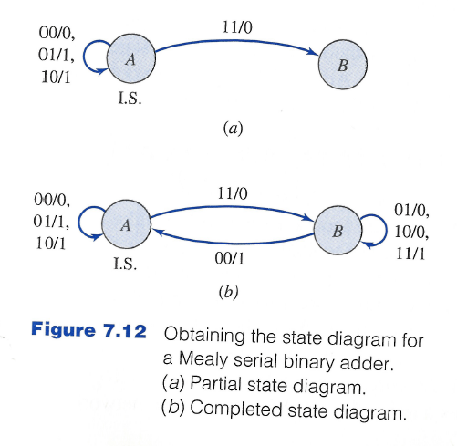
State Diagram for Mealy serial binary adder

Slide 7
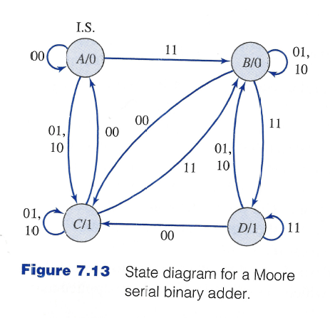
State Diagram for Moore serial binary adder

Slide 8
A Sequence Recognizer
An output of 1 is to be produced iff the three input symbols following two consecutive input 0’s include at least one 1.
At all other times the output is to be 0.
The output of 1 is to be coincident with the third input symbol of the three-input-symbol sequence.
Upon completing the analysis of the three input symbols followin the pair of 0 inputs, the network is to reset itself and await for another pair of 0’s and then at least one 1 in the following seqence of three input symbols.
Since the output is to be coincident with the third input symbol, a Mealy netword is implied.
Example:
x | = | 0 | 1 | 0 | 0 | 0 | 1 | 0 | 0 | 1 | 0 | 0 | 1 | 0 | 0 | 1 | 0 | 0 | 0 | 0 | 0 | 0 | 0 | 0 | 1 | 1
z | = | 0 | 0 | 0 | 0 | 0 | 0 | 1 | 0 | 0 | 0 | 0 | 0 | 0 | 1 | 0 | 0 | 0 | 0 | 0 | 0 | 0 | 0 | 0 | 0 | 1

Slide 9
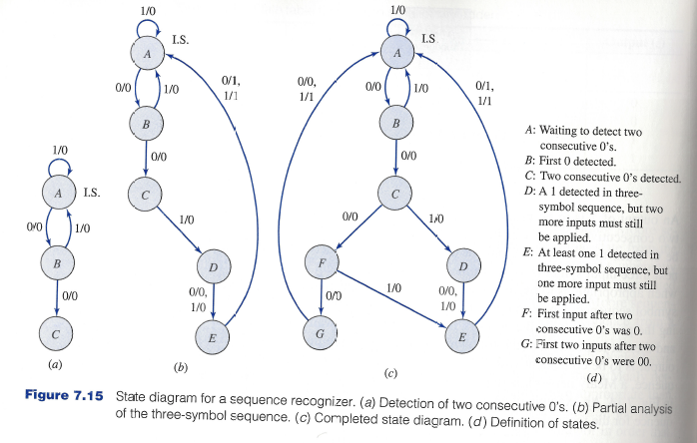
A Sequence Recognizer

Slide 10
Another Sequence Recognizer
Network produces a 1 output iff the current input and the previous three inputs correspond to either 0110 or 1001
0110/1001 Sequence Recognizer
The 1 output is to occur at the time of the fourth input of the recognized sequence. Outputs of 0 are to be produced at all other times.
A Mealy network model is developed since the output is a function of the current input x.
Network is not required to reset upon the occurrence of the fourth input.
Sequences may overlap.
Example:
x | = | 0 | 0 | 1 | 1 | 0 | 1 | 1 | 1 | 0 | 0 | 1 | 0 | 1 | 0 | 1 | 1 | 0 | 0 | 1 | 1 | 0 | 0 | 1 | 0 | 1
z | = | 0 | 0 | 0 | 0 | 1 | 0 | 0 | 0 | 0 | 0 | 1 | 0 | 0 | 0 | 0 | 0 | 1 | 0 | 1 | 0 | 1 | 0 | 1 | 0 | 0

Slide 11
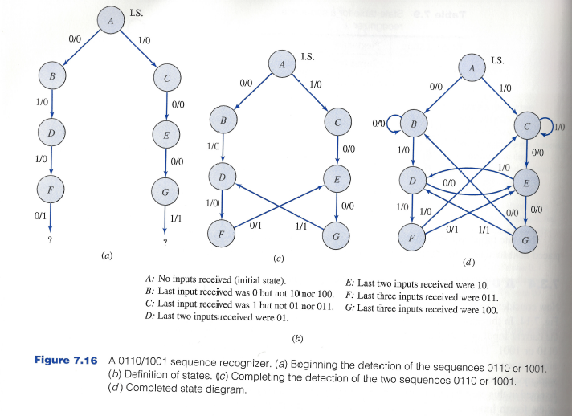
Another Sequence Recognizer

Slide 12
Final Example
Single input $x$ and a single output $z$.
The output of the network is initially 0.
Changes on the next input immediately following each even occurrence of $x=1$.
The effect of the input is to be delayed by one clock period. The value of $x$ during the next clock period does not affect the output of the network at that time.
A Moore sequential network is to be realized
Example:
x | = | 0 | 0 | 1 | 1 | 0 | 0 | 0 | 1 | 0 | 1 | 0 | 1 | 1 | 1 | 0
 |  |  |  |  | a |  |  |  |  |  | b |  |  | c
z | = | 0 | 0 | 0 | 0 | 1 | 1 | 1 | 1 | 1 | 1 | 0 | 0 | 0 | 1 | 1

Slide 13
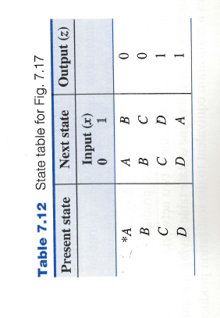
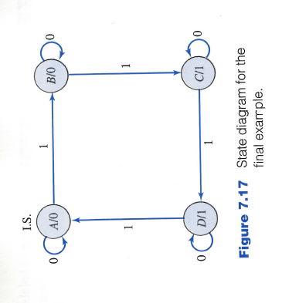
Final Example
A: The output changes to 0 since the last occurrence of $x=1$ was even
B: The output remains at 0 since the last occurrence of $x=1$ was odd
C: The output changes to 1 since the last occurrence of $x=1$ was even
D: The output remains at 1 since the last occurrence of $x=1$ was odd

Slide 14
State Table Reduction

Slide 15
State Table Reduction
The state table is a description of the terminal behavior of a clocked synchronous sequential network.
During the process of creating the state table, more states may be defined then are really necessary.
In analysis of synchronous sequential networks, bin codes for the states were replaced by arbitrary symbols when going from transition table to state table.
For synthesis, the opposite process is performed: Arbitrary state symbols are replaced with binary codes.
Smaller number of binary digits necessary -> smaller number of flip-flops.
Reducing number of states may also simplify the combinational logic.

Slide 16
State Table Reduction Procedure
3-step process:
Equivalent pairs of states are determined
Sets of equivalent states are established
Reduced state table is constructed with one state for each of the sets of equivalent states

Slide 17
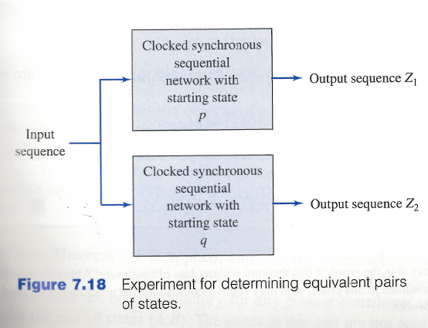
Determining Equivalent Pairs of States
Recall that given a state table, an input sequence and some starting state, the resulting output sequence can be determined.
Assume we run two experiments:
One starts in state p
The second starts in state q

Slide 18
Determining Equivalent Pairs of States
States $p$ and $q$ are said to be equivalent or indistinguishable $\left(p≡q\right)$ iff for all input sequences applied to the two starting states, identical output sequences from both networks result $\left(Z_{1}≡Z_{2}\right)$.
If states $p$ and $q$ are not equivalent, then they are said to be distinguishable $\left(p≠q\right).$

Slide 19
Determining Equivalent Pairs of States
Theorem:
Two states $p$ and $q$ of a clocked synchronous sequential network are equivalent iff for each combination of values of the input variables
Their outputs are identical
Their next states are equivalent

Slide 20
Determining Equivalent Pairs of States
Proof: First direction:
If the states are equivalent, then for each combination of values of the input variables
Their outputs are identical
Their next states are equivalent
Assume there is some input combination such that outputs differ. Then clearly $p≠q.$
Assume there is some input combination $X$ such that next states $\left(p^{′}, q^{′}\right)$ are distinguishable. Then by definition of distinguishable, there is some input sequence $X^{′}$for states $p^{′},q^{′}$ that produces different output sequences. Thus, $X,X′$ is a distinguishing input sequence for $p,q$ and so $p≠q.$

Slide 21
Determining Equivalent Pairs of States
Proof: Second direction
If for each combination of values of the input variables
Their outputs are identical
Their next states are equivalent
Then the two states are equivalent.
Assume $p,q$ are not equivalent. Then there is some input sequence $X=xX′$ such that the outputs $Z_{1}=z_{1}{Z_{}^{′}}_{1}$ and $Z_{2}=z_{2}{Z_{}^{′}}_{2}$ differ. Assume that $p^{′},q′$ are the pair of next states on this input.
If $z_{1}≠z_{2},$ then condition 1 is not satisfied.
If $z_{1}=z_{2}$, then $X′$ must be an input sequence such that the outputs ${Z_{}^{′}}_{1}, {Z_{}^{′}}_{2}$ differ. Then $p^{′}≠q^{′}$ and condition 2 is not satisfied.

Slide 22
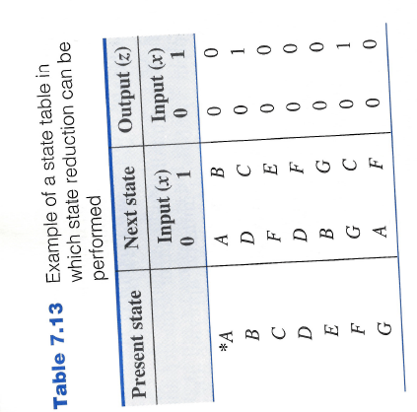
Example of State Table in Which State Reduction can be performed
$A≡B?$
No. Why not?
$$A≡E?$$
No. Why not?
$$A≡D?$$
Need to check $B≡F$
Circle back to $A≡D$
So yes, $A≡D$.

Slide 23
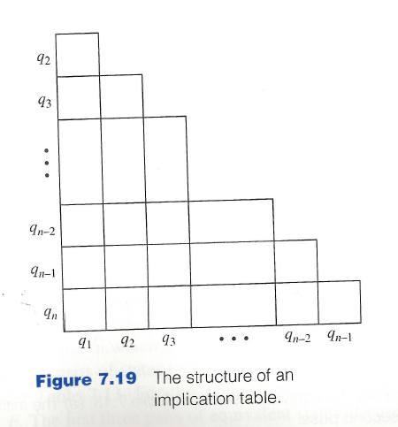
Algorithm for Determining Equivalent Pairs of States
Uses an implication table
$q_{1}, …, q_{n}$ are the states of the state table. There is one cell in the implication table for each pair of distinct cells.

Slide 24
Algorithm for Determining Equivalent Pairs of States
Place a $×$ in the $\left(q_{i}, q_{j}\right)$-cell if the outputs are contradictory for some input. If there are no contradictory outputs then enter the pair of next states for each input. If neither a $×$ nor pairs of states are entered in the cell, then a check mark is inserted (denoting equivalence of the two states).
All state pair entries are inspected by the following process:
If $(q_{a},q_{b})$ is an entry in the $(q_{i}, q_{j})$-cell and if the $\left(q_{a}, q_{b}\right)$-cell contains an $×$ then an $×$ is placed in the the $(q_{i}, q_{j})$-cell and all other entries are ignored.
Otherwise, process is repeated on one of these other state pairs.
Repeat Step 2 until it is possible to make an entire pass of the implication table without any additional $×$ being entered. If the $(q_{i}, q_{j})$-cell has no $×$ at this time, then $q_{i}≡q_{j}.$

Slide 25
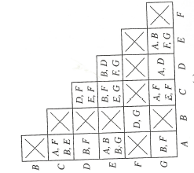
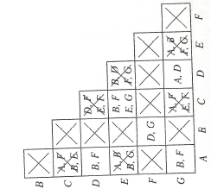
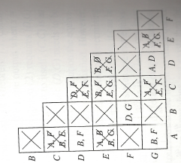
Example of Algorithm

Slide 26
Algorithm for Obtaining the Equivalence Classes of States
Starting with the rightmost column of the processed implication table and working toward the left, move to the first column that has a cell that does not contain a $×$. Write down the pairs of equivalent states for this column.
Move to the next column to the left, column $i$, which contains one or more non $×$ cells. If state $i$ is equivalent to all members of any set of states in the list, then add state $i$ to the set. Otherwise, add to the list the pairwise equivalent states containing state $i$.
Repeat Step 2 until all columns are examined. Add to the list, as sets consisting of single states, any states that do not appear in one of the other sets in the list.

Slide 27
Example for Implication Table
$\left(D,G\right)$
$\left(D,G\right), \left(B,F\right)$
$\left(A,D,G\right), \left(B,F\right)$
$\left(A,D,G\right), \left(B,F\right), \left(C\right),(E)$

Slide 28
Constructing the Minimal State Table
Original state table is $Q$ and minimal state table is $P.$ The set of states making up the equivalence classes are denoted $C_{1}, …, C_{s}$. The input columns for state tables $P$ and $Q$ are the same and denoted $I_{1}, …, I_{m}.$
Assign a state $p_{i}$ to each of the sets $C_{i}$ for $i=1,2, …, s.$ The present state section of table $P$ consists of $p_{1}, …, p_{s}.$
To determine the next-state entry in the $p_{i}$-row, $I_{k}$-column of table $P$:
Select any state in the set $C_{i}$. Use state table $Q$ to determine its next state for input $I_{k}.$
Next state is in some set $C_{j}$ so table entry is $p_{j}$
Output entries are determined similarly.
If the initial state of state table $Q$ is a member of $C_{r}$ then $p_{r}$ is the initial state of state table $P.$

Slide 29
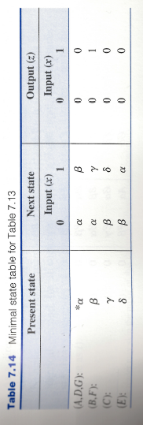
Constructing the Minimal State Table

