Slide 1
Digital Logic Design
Lecture 28

Slide 2
Announcements
Homework 9 due on Thursday 12/11
Please fill out Course Evaluations online.
Final exam will be on Thursday, Dec. 18 10:30-12:30 in CHE 2118 (our regular classroom).
Shang will hold a review for the final exam in AVW 2120.
Vote on time for review session:
Friday, 12/12 from 11am-12:15pm
Friday, 12/12 from 12:30pm-1:45pm

Slide 3
Agenda
Last Time:
Modeling Clocked Synchronous Sequential Network Behavior (7.3)
This time:
State Table Reduction (7.4)
The State Assignment (7.5)
Completing the Design of Clocked Synchronous Sequential Networks (7.6)

Slide 4
Determining Equivalent Pairs of States
Theorem:
Two states $p$ and $q$ of a clocked synchronous sequential network are equivalent iff for each combination of values of the input variables
Their outputs are identical
Their next states are equivalent

Slide 5
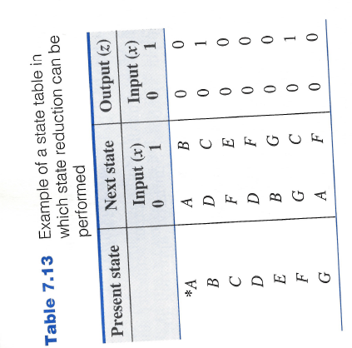
Example of State Table in Which State Reduction can be performed
$A≡B?$
No. Why not?
$$A≡E?$$
No. Why not?
$$A≡D?$$
Need to check $B≡F$
Circle back to $A≡D$
So yes, $A≡D$.

Slide 6
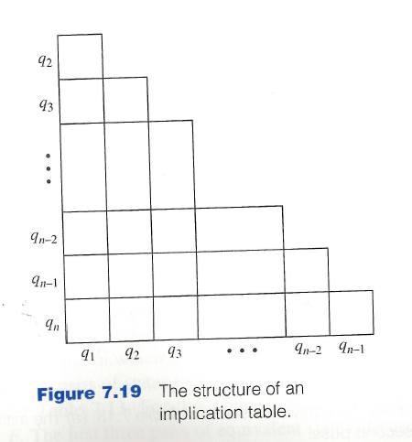
Algorithm for Determining Equivalent Pairs of States
Uses an implication table
$q_{1}, …, q_{n}$ are the states of the state table. There is one cell in the implication table for each pair of distinct cells.

Slide 7
Algorithm for Determining Equivalent Pairs of States
Place a $×$ in the $\left(q_{i}, q_{j}\right)$-cell if the outputs are contradictory for some input. If there are no contradictory outputs then enter the pair of next states for each input. If neither a $×$ nor pairs of states are entered in the cell, then a check mark is inserted (denoting equivalence of the two states).
All state pair entries are inspected by the following process:
If $(q_{a},q_{b})$ is an entry in the $(q_{i}, q_{j})$-cell and if the $\left(q_{a}, q_{b}\right)$-cell contains an $×$ then an $×$ is placed in the the $(q_{i}, q_{j})$-cell and all other entries are ignored.
Otherwise, process is repeated on one of these other state pairs.
**Next-state pairs of the form $\left(q_{i}, q_{j}\right), \left(q_{j}, q_{i}\right)$ or $\left(q_{k}, q_{k}\right)$ are not entered.
Repeat Step 2 until it is possible to make an entire pass of the implication table without any additional $×$ being entered. If the $(q_{i}, q_{j})$-cell has no $×$ at this time, then $q_{i}≡q_{j}.$

Slide 8
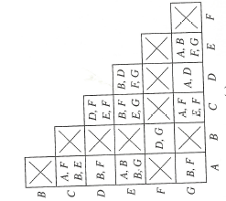
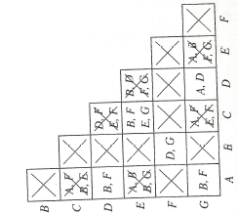
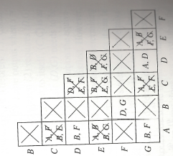
Example of Algorithm

Slide 9
Algorithm for Obtaining the Equivalence Classes of States
Starting with the rightmost column of the processed implication table and working toward the left, move to the first column that has a cell that does not contain a $×$. Write down the pairs of equivalent states for this column.
Move to the next column to the left, column $i$, which contains one or more non $×$ cells. If state $i$ is equivalent to all members of any set of states in the list, then add state $i$ to the set. Otherwise, add to the list the pairwise equivalent states containing state $i$.
Repeat Step 2 until all columns are examined. Add to the list, as sets consisting of single states, any states that do not appear in one of the other sets in the list.

Slide 10
Example for Implication Table
$\left(D,G\right)$
$\left(D,G\right), \left(B,F\right)$
$\left(A,D,G\right), \left(B,F\right)$
$\left(A,D,G\right), \left(B,F\right), \left(C\right),(E)$

Slide 11
Constructing the Minimal State Table
Original state table is $Q$ and minimal state table is $P.$ The set of states making up the equivalence classes are denoted $C_{1}, …, C_{s}$. The input columns for state tables $P$ and $Q$ are the same and denoted $I_{1}, …, I_{m}.$
Assign a state $p_{i}$ to each of the sets $C_{i}$ for $i=1,2, …, s.$ The present state section of table $P$ consists of $p_{1}, …, p_{s}.$
To determine the next-state entry in the $p_{i}$-row, $I_{k}$-column of table $P$:
Select any state in the set $C_{i}$. Use state table $Q$ to determine its next state for input $I_{k}.$
Next state is in some set $C_{j}$ so table entry is $p_{j}$
Output entries are determined similarly.
If the initial state of state table $Q$ is a member of $C_{r}$ then $p_{r}$ is the initial state of state table $P.$

Slide 12
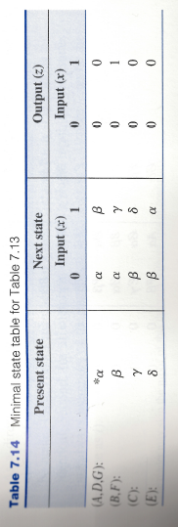
Constructing the Minimal State Table

Slide 13
Next Step: Constructing Transition Table from State Table
A binary code representation for the states of the state table is selected.
This is referred to as the state-assignment problem.
Different state assignments result in realizations of different costs.
We want to find a state assignment that minimizes the cost of the network realization.

Slide 14
State Assignment
If there are $s$ states to be coded, the minimum number of binary digits $p$ required is the smallest integer greater than or equal to the base-2 logarithm of $s$.
This guarantees minimal number of flip-flops but not necessarily minimum cost realization.
Even using the minimum binary digits the state assignment problem is not necessarily simple.
There are $2^{p}!/\left(2^{p}−s\right)!$ Ways of assignming a unique binary code of $p$ digits to the $s$ states.
For a six-row state table in which 3 binary digits are used to code each state, there are 20,160 different state assignemnts.

Slide 15
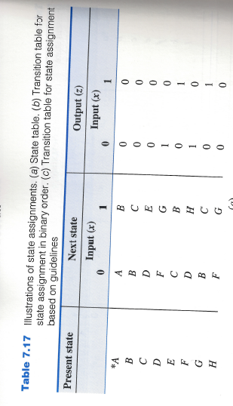
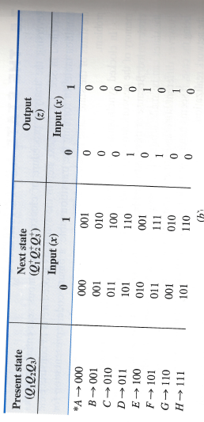
Simplest Approach
Use the first $s$ binary integers as the binary-code representation of the $s$ states.

Slide 16
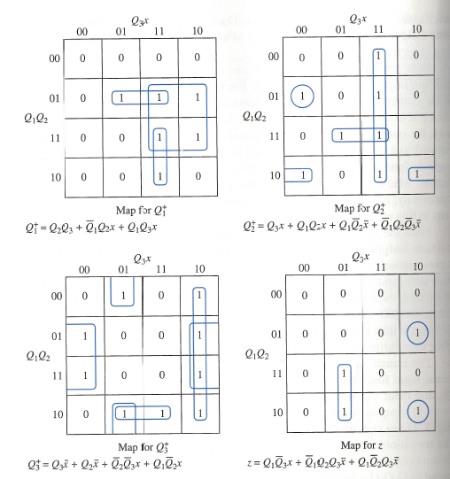
Next-State and Output K-maps

Slide 17
Guidelines for Obtaining State Assignments
Define two states as being adjacent if their binary codes differ in exactly one bit.
Two input combinations are adjacent if they differ in exactly one bit.

Slide 18
Guidelines for Obtaining State Assignments
Rule I: Two or more present states that have the same next state for a given input combination should be made adjacent.
Rule II: For any present state and two adjacent input combinations, the two next states should be made adjacent.
Rule III: Two or more present states that produce the same output symbol, for a given input combination should be made adjacent (only needs to be done for one of the two output symbols).

Slide 19
Rationale for Guidelines
$n$ input variables $p$ state variables.
Consider $(n+p)$-variable K-maps for each bit of next state and output.
Rule I: provide for large subcubes on K-map by causing identical entries to appear in adjacent cells.
Rule II: Cells in K-map will be the same for $p−1$ of the maps corresponding to bits of the state.
Rule III: Does to the output maps what Rule I does to the next-state maps.

Slide 20
Example
State $B$ is the next state for both present states $B,G$ when $x=0$. Rule 1: $B,G$ should be adjacent.
States $C,F$ should be coded as adjacent states since their next states are both state $D$.
States $D,H$ should be coded as adjacent states since their next states are both $F$.
Rule I: $\left(B,G\right)\left(2×\right), \left(C,F\right), \left(D,H\right)\left(2×\right), (A,E)$
$(2×)$ indicates that the recommended adjacency conditions appear twice and should be given higher priority than those that appear only once.

Slide 21
Example
Next consider Rule II:
Since $x=0, x=1$ are adjacent, the next-state pair for each present state should be made adjacent according to Rule II.
Rule II: $\left(A,B\right), \left(B,C\right)\left(3×\right), \left(D,E\right),\left(F,G\right)\left(2×\right),(D,H)$

Slide 22
Example
Next consider Rule III:
Look at present states that produce output symbol 1 on the same input.
Rule III: $\left(D,F\right),(E,G)$

Slide 23
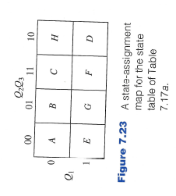
State Assignment Map
K-map for the state variables in which each cell of the map denotes a combination of the binary digits that can be assigned to a state of the sequential network.

Slide 24
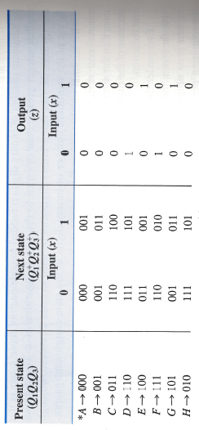
Transition Table
Using the state assignment map and state table, a transition table is constructed.

Slide 25
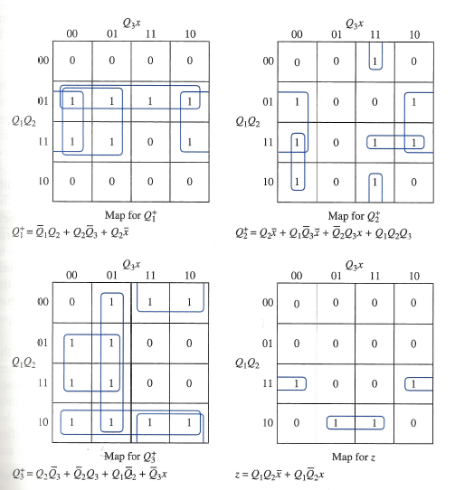
Transition Table
K-maps for next-state and output functions.

