Slide 1
Digital Logic Design
Lecture 29

Slide 2
Announcements
Homework 9 due today
Please fill out Course Evaluations online.
Final exam will be on Thursday, Dec. 18 10:30-12:30 in CHE 2118 (our regular classroom).
Shang will hold a review for the final exam in AVW 2120 on Friday, 12/12 from 11am-12:15pm.
Information about final exam (including review problems for the review session) now up on course webpage.

Slide 3
Agenda
Last Time:
State Table Reduction (7.4)
The State Assignment Problem (7.5)
This Time:
Finish The State Assignment Problem (7.5)
Completing the Design of Clocked Synchronous Sequential Networks (7.6)

Slide 4
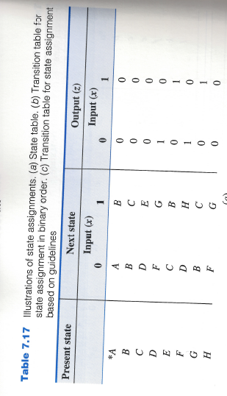
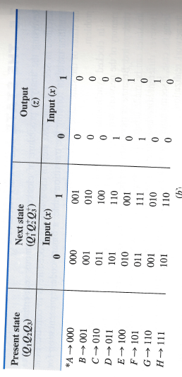
Simplest Approach
Use the first $s$ binary integers as the binary-code representation of the $s$ states.

Slide 5
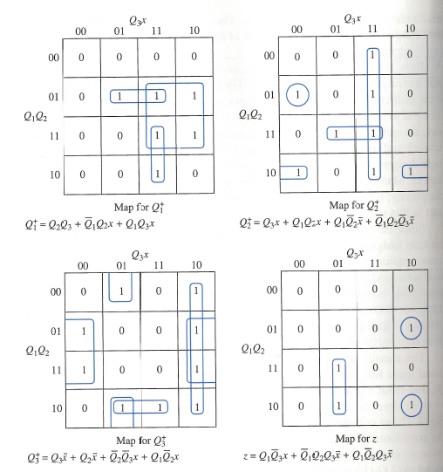
Next-State and Output K-maps

Slide 6
Guidelines for Obtaining State Assignments
Rule I: Two or more present states that have the same next state for a given input combination should be made adjacent.
Rule II: For any present state and two adjacent input combinations, the two next states should be made adjacent.
Rule III: Two or more present states that produce the same output symbol, for a given input combination should be made adjacent (only needs to be done for one of the two output symbols).

Slide 7
Example
State $B$ is the next state for both present states $B,G$ when $x=0$. Rule 1: $B,G$ should be adjacent.
States $C,F$ should be coded as adjacent states since their next states are both state $D$.
States $D,H$ should be coded as adjacent states since their next states are both $F$.
Rule I: $\left(B,G\right)\left(2×\right), \left(C,F\right), \left(D,H\right)\left(2×\right), (A,E)$
$(2×)$ indicates that the recommended adjacency conditions appear twice and should be given higher priority than those that appear only once.

Slide 8
Example
Next consider Rule II:
Since $x=0, x=1$ are adjacent, the next-state pair for each present state should be made adjacent according to Rule II.
Rule II: $\left(A,B\right), \left(B,C\right)\left(3×\right), \left(D,E\right),\left(F,G\right)\left(2×\right),(D,H)$

Slide 9
Example
Next consider Rule III:
Look at present states that produce output symbol 1 on the same input.
Rule III: $\left(D,F\right),(E,G)$

Slide 10
State Assignment Map
K-map for the state variables in which each cell of the map denotes a combination of the binary digits that can be assigned to a state of the sequential network.
(B,G) 2x
(C,F)
(D,H) 2x
(A,E)
(A,B)
(B,C) 3x
(D,E)
(F,G) 2x
(D,H)
(D,F)
(E,G)
I.S.
A

Slide 11
State Assignment Map
K-map for the state variables in which each cell of the map denotes a combination of the binary digits that can be assigned to a state of the sequential network.
(B,G) 2x
(C,F)
(D,H) 2x
(A,E)
(A,B)
(B,C) 3x
(D,E)
(F,G) 2x
(D,H)
(D,F)
(E,G)
I.S.
A | B

Slide 12
State Assignment Map
K-map for the state variables in which each cell of the map denotes a combination of the binary digits that can be assigned to a state of the sequential network.
(B,G) 2x
(C,F)
(D,H) 2x
(A,E)
(A,B)
(B,C) 3x
(D,E)
(F,G) 2x
(D,H)
(D,F)
(E,G)
I.S.
A | B | G

Slide 13
State Assignment Map
K-map for the state variables in which each cell of the map denotes a combination of the binary digits that can be assigned to a state of the sequential network.
(B,G) 2x
(C,F)
(D,H) 2x
(A,E)
(A,B)
(B,C) 3x
(D,E)
(F,G) 2x
(D,H)
(D,F)
(E,G)
I.S.
A | B | G
 | C

Slide 14
State Assignment Map
K-map for the state variables in which each cell of the map denotes a combination of the binary digits that can be assigned to a state of the sequential network.
(B,G) 2x
(C,F)
(D,H) 2x
(A,E)
(A,B)
(B,C) 3x
(D,E)
(F,G) 2x
(D,H)
(D,F)
(E,G)
I.S.
A | B | G | E
 | C

Slide 15
State Assignment Map
K-map for the state variables in which each cell of the map denotes a combination of the binary digits that can be assigned to a state of the sequential network.
(B,G) 2x
(C,F)
(D,H) 2x
(A,E)
(A,B)
(B,C) 3x
(D,E)
(F,G) 2x
(D,H)
(D,F)
(E,G)
I.S.
A | B | G | E
 | C |  | D

Slide 16
State Assignment Map
K-map for the state variables in which each cell of the map denotes a combination of the binary digits that can be assigned to a state of the sequential network.
(B,G) 2x
(C,F)
(D,H) 2x
(A,E)
(A,B)
(B,C) 3x
(D,E)
(F,G) 2x
(D,H)
(D,F)
(E,G)
I.S.
A | B | G | E
 | C | F | D

Slide 17
State Assignment Map
K-map for the state variables in which each cell of the map denotes a combination of the binary digits that can be assigned to a state of the sequential network.
(B,G) 2x
(C,F)
(D,H) 2x
(A,E)
(A,B)
(B,C) 3x
(D,E)
(F,G) 2x
(D,H)
(D,F)
(E,G)
I.S.
A | B | G | E
H | C | F | D

Slide 18
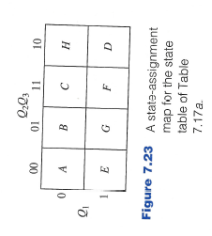
State Assignment Map
K-map for the state variables in which each cell of the map denotes a combination of the binary digits that can be assigned to a state of the sequential network.

Slide 19
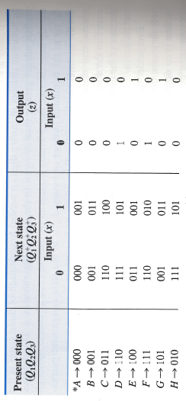
Transition Table
Using the state assignment map and state table, a transition table is constructed.

Slide 20
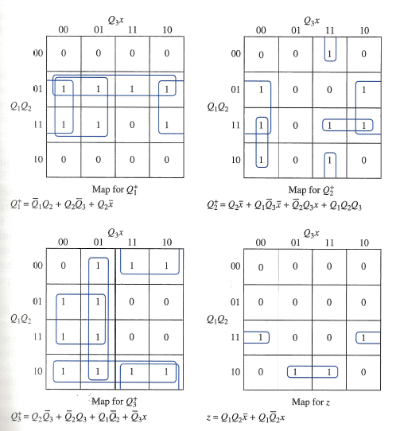
Transition Table
K-maps for next-state and output functions.

Slide 21
Next-State and Output K-maps

Slide 22
Unused States
With $p$ bits, the number of states $s$ that can be coded is given by
$$2^{p−1}<s≤2^{p}$$
In general, when coding $s$ states with $p$ bits some binary combinations are not assigned to any state.

Slide 23
Unused States
Approach 1:
The corresponding entries in the K-maps are don’t cares.
This provides greater flexibility when obtaining minimal expressions for next-state and output functions.
Approach 2:
The network may enter one of the unused states (when first turned on, due to noise, hardware failure, etc.)
It may be desirable that the network go to some well-defined state at the end of the clock period.
Next state entries for each of the unused states should be specified.

Slide 24
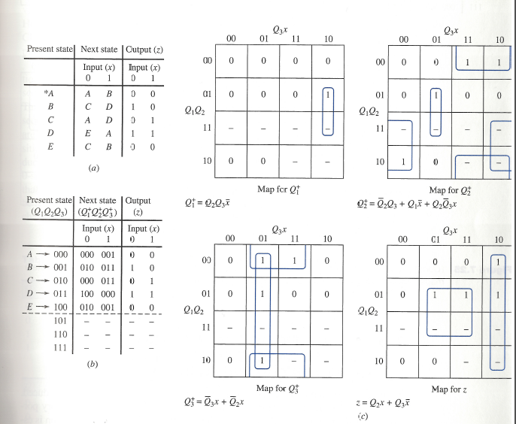
Illustrating Approach 1

Slide 25
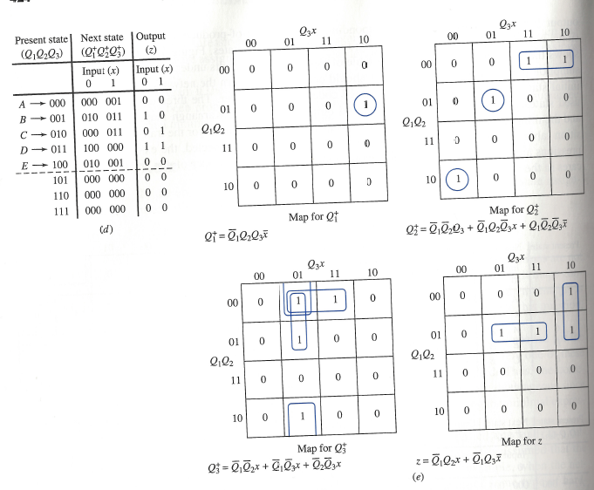
Illustrating Approach 2

Slide 26
Completing the Design
Choose which type of clocked flip-flops should be used for memory.
Depending on this choice, appropriate excitation signals must be generated by the combinational logic that precedes the input terminals of the flip-flops.
Excitation table can be constructed from transition table once flip-flop type is selected.

Slide 27
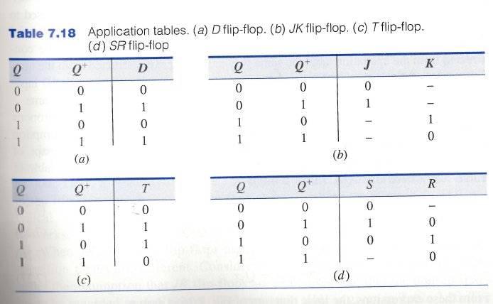
Application tables for Flip-Flops

Slide 28
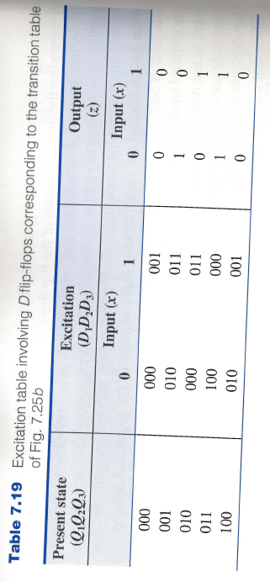
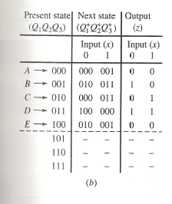
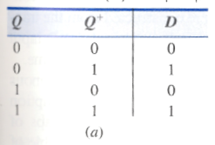
From Transition Table to Excitation Table

Slide 29
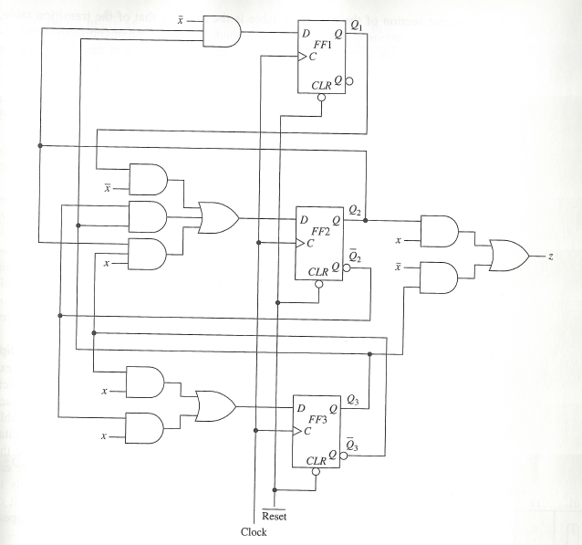
Completing the Design with D-flip-flops
$$D_{1}=Q_{2}Q_{3}\overline{x}$$
$$D_{2}={\overline{Q}}_{2}Q_{3}+Q_{1}\overline{x}+Q_{2}{\overline{Q}}_{3}x$$
$$D_{3}={\overline{Q}}_{3}x+{\overline{Q}}_{2}x$$
$$z=Q_{2}x+Q_{3}\overline{x}$$

Slide 30
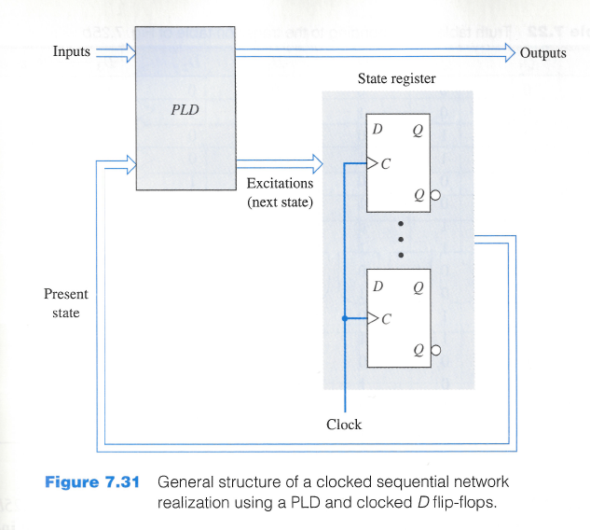
Realizations using PLDs

Slide 31
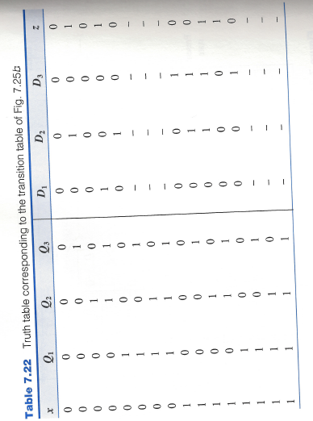
PROM Realization

Slide 32
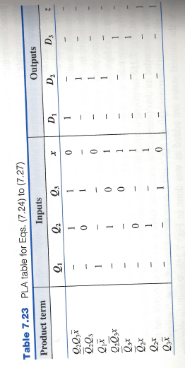
PLA Realization
$$D_{1}=Q_{2}Q_{3}\overline{x}$$
$$D_{2}={\overline{Q}}_{2}Q_{3}+Q_{1}\overline{x}+Q_{2}{\overline{Q}}_{3}x$$
$$D_{3}={\overline{Q}}_{3}x+{\overline{Q}}_{2}x$$
$$z=Q_{2}x+Q_{3}\overline{x}$$

Slide 33
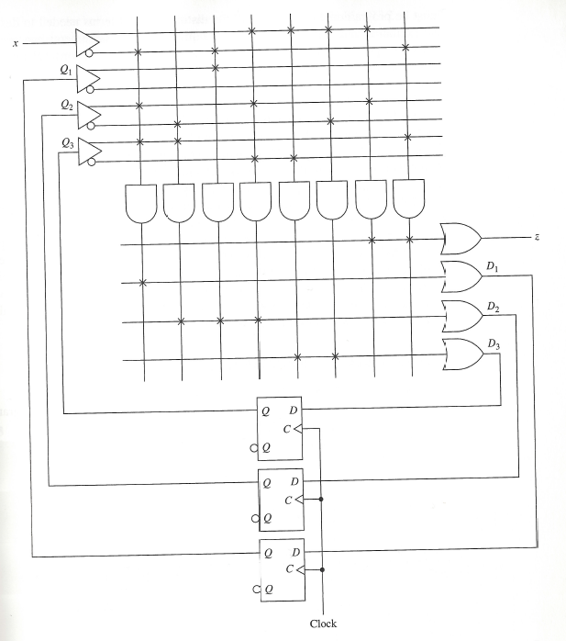
PLA Realization

Slide 34
Additional Example

Slide 35
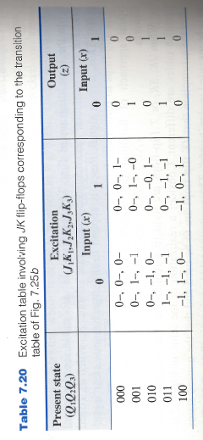
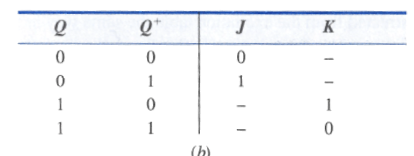
From Transition Table to Excitation Table

Slide 36
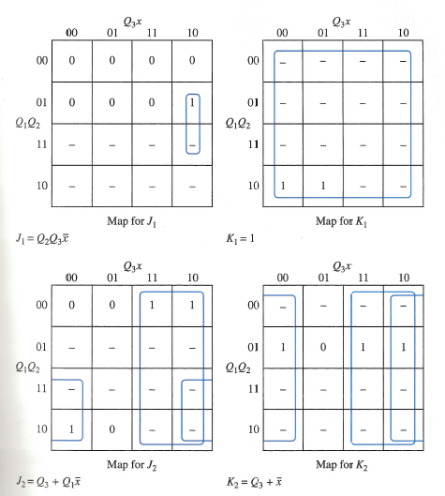
K-Maps

Slide 37
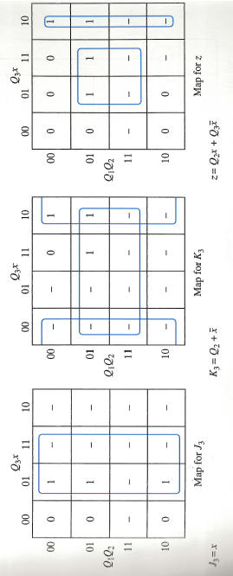
K-Maps

Slide 38
Additional Example

Slide 39
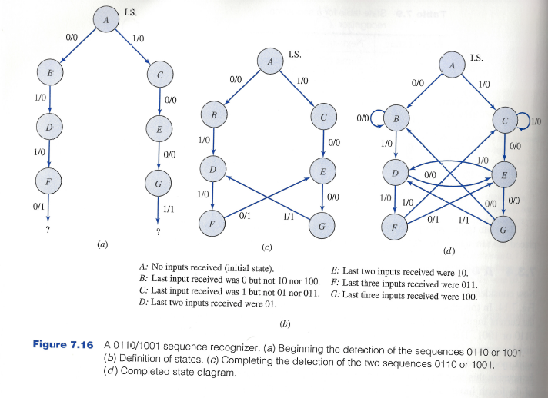
Recall 0110/1001 Sequence Recognizer

Slide 40
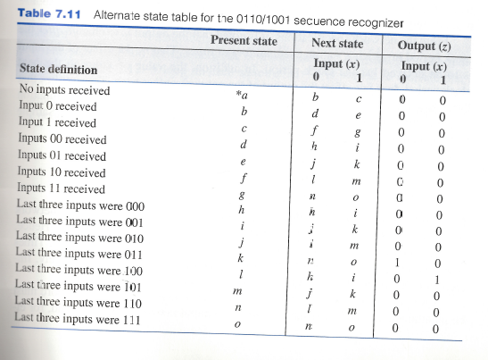
Alternative State Table

Slide 41
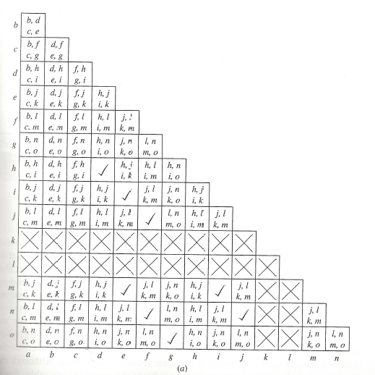
Implication Table

Slide 42
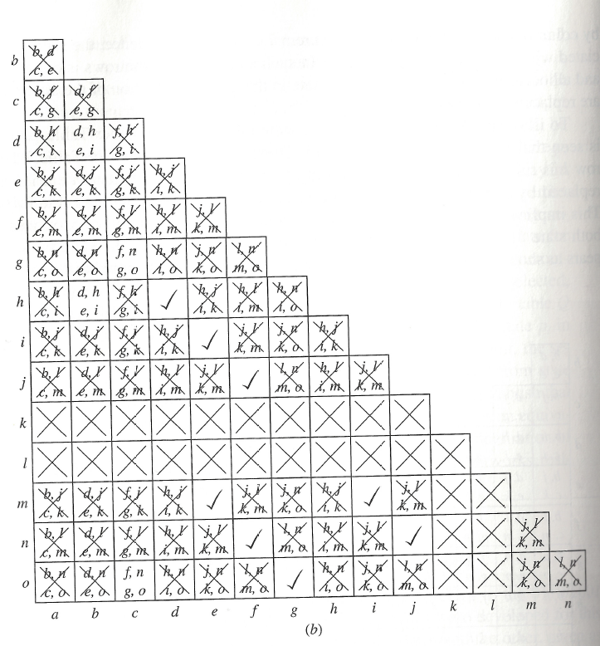
Implication Table

